Slide 1

Website Walkthrough
March 21, 2018

Slide 2
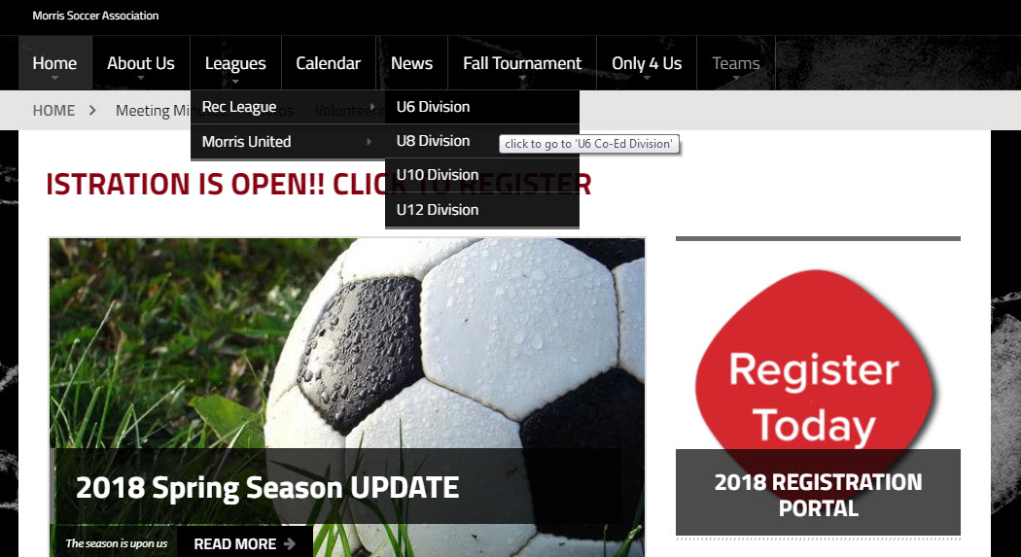
Where’s my team?
Hover on Leagues
Rec League will provide you additional Divisions
Click on your child’s appropriate Division

Slide 3
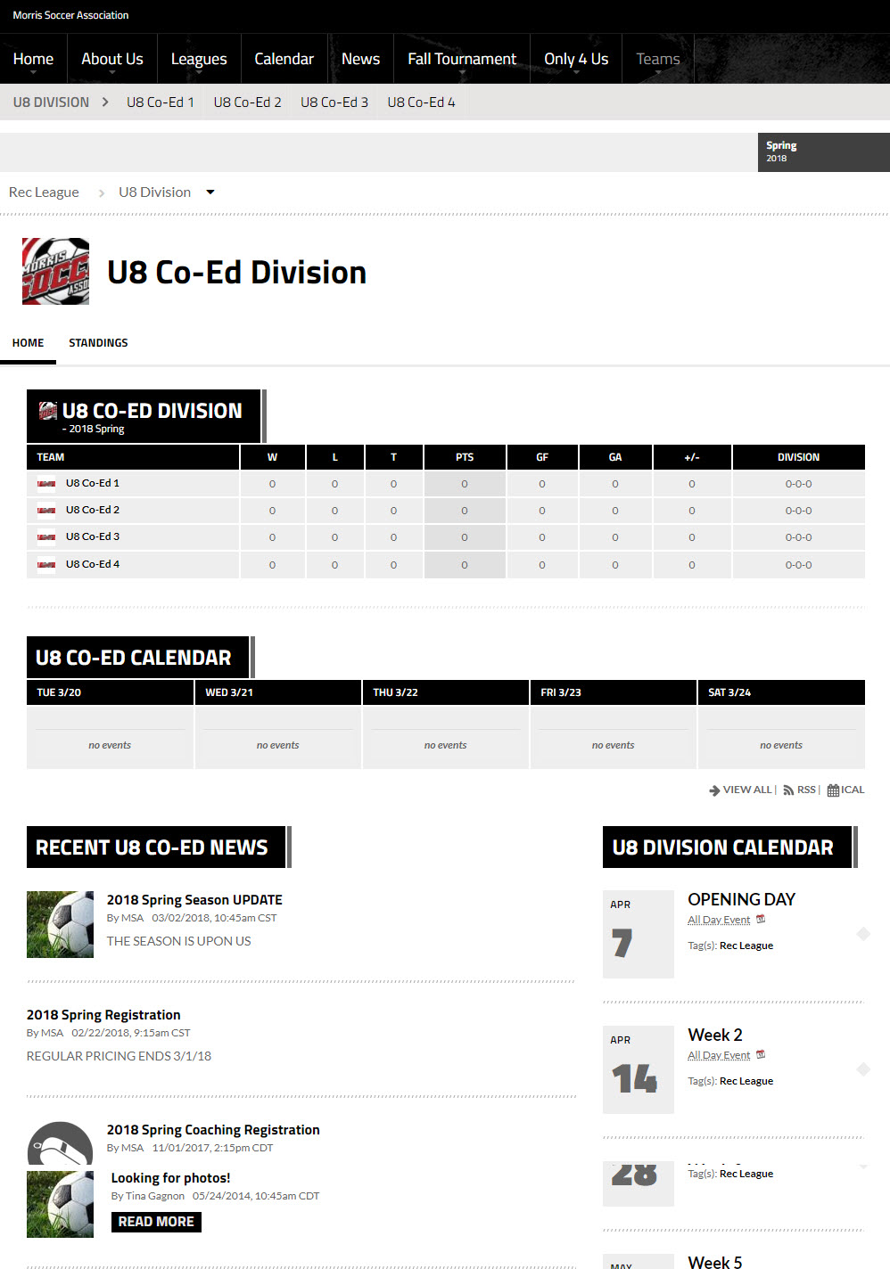
Where’s my team?
Click the team for your child. This will take you to the specific team page
The Division Main Page will also provide:
Standings;
Upcoming Division tagged events; and
Division tagged News

Slide 4
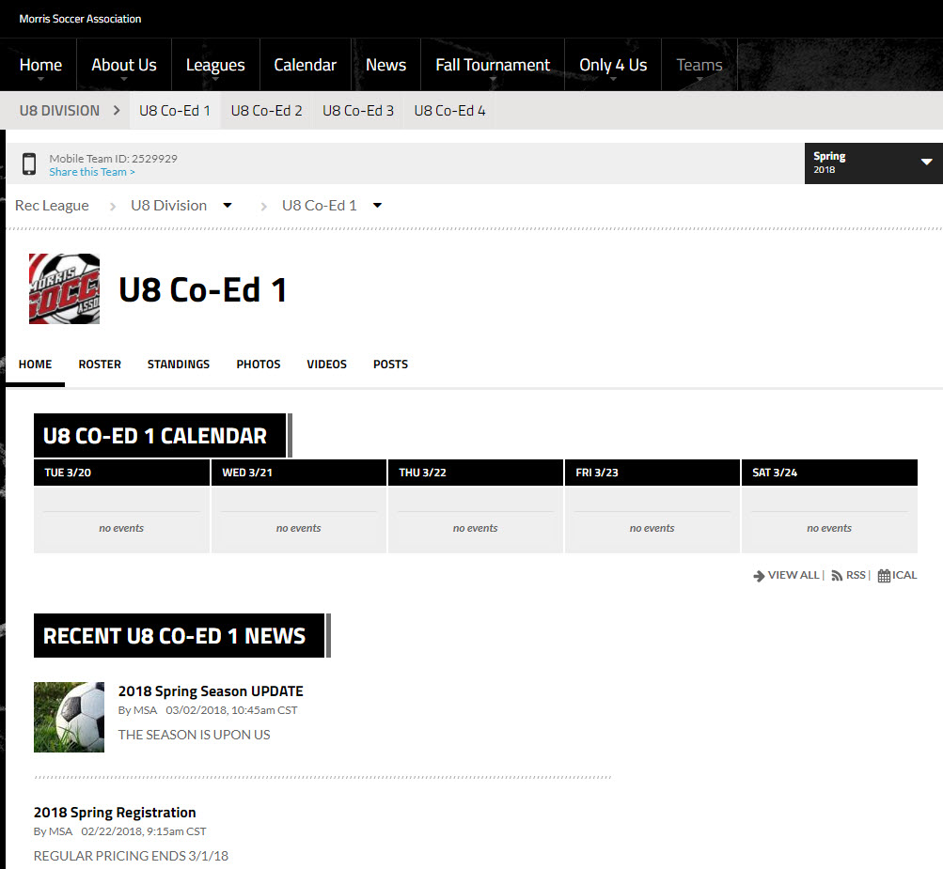
Team Page
Team ID used to link your team to the SportsEngine Mobile Application
Home – Main content page (shown right)
Roster – Players and Coaches on the team
Standings – Division Standings
When games are scheduled, there will also be a button for Game Schedule

Slide 5
If you have any other questions regarding the website or content, please email the webmaster: webmastersMSA@gmail.com

