Slide 1


LACROSSE ATHLETE DEVELOPMENT MODEL in Western Maryland
Doug Agnes
WMDUSLAX Sport Dev Dir
WMYLC Education Coord.
doug.agnes@wmduslax.org
The Right Lacrosse at the Right Time!

Slide 2
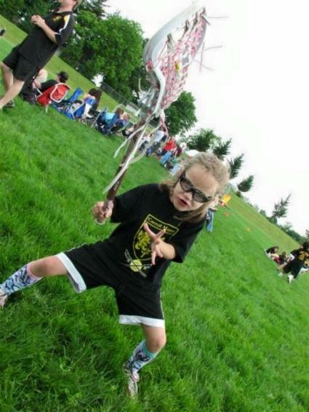
Lacrosse Athlete Dev Model
What is it?
Why are we changing?
Implementation in WMYLC
Common Concerns
Where can I find out more?
Video Clip

Slide 3
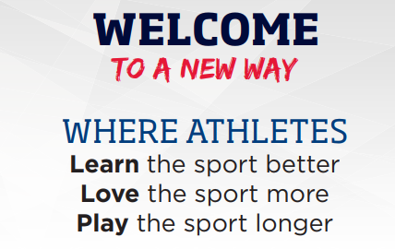
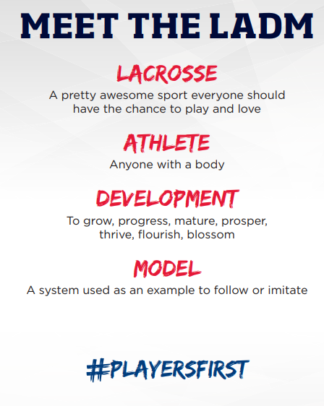
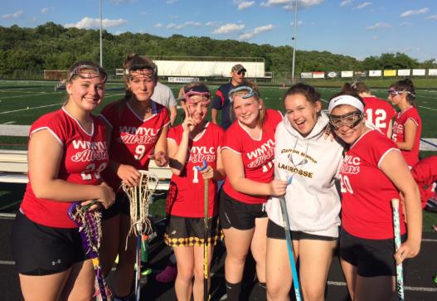
LADM What is it?

Slide 4
LADM What is it?
LADM Values:
Designed for Development
Fun & Kid Centered
Small Sided Competition & Free Play
Coach Training
Physical Literacy (Teach Athleticism)
Encourage Multi-Sport Participation

Slide 5
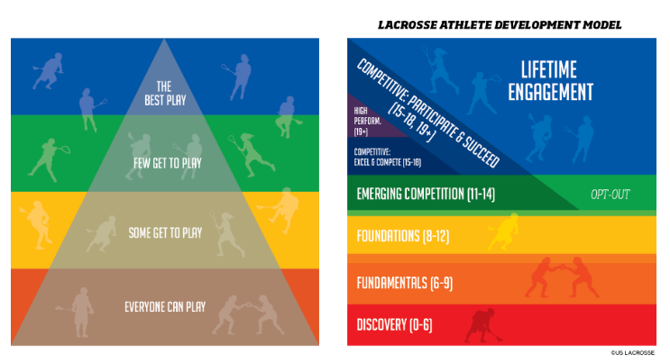
LADM – What is it?
The way we’ve always done it…
Athlete Development Model

Slide 6
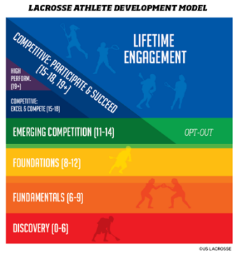
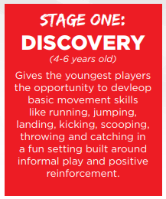
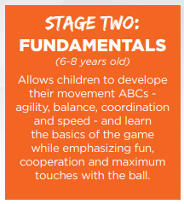
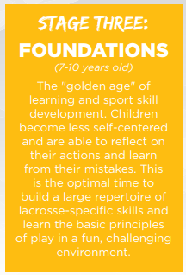
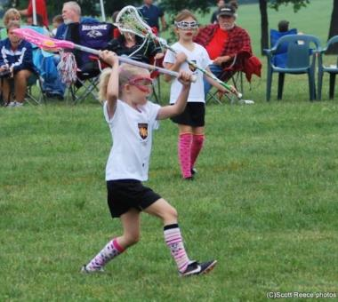
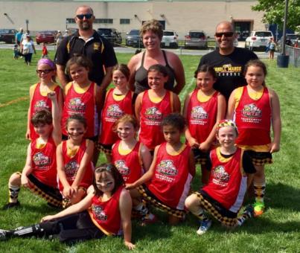
LADM – What is it?
STAGES of Development

Slide 7
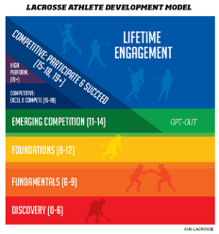
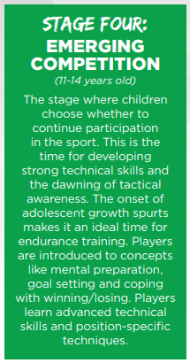
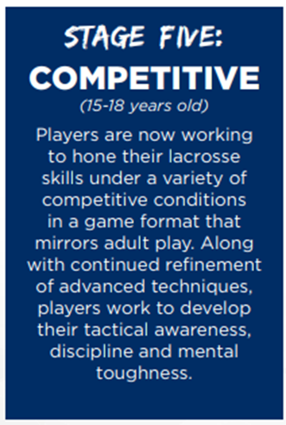
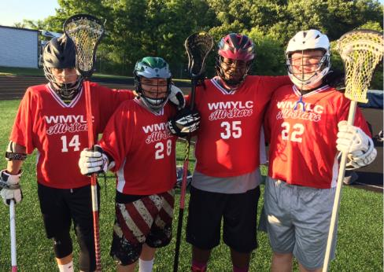
LADM – What is it?
STAGES of Development

Slide 8
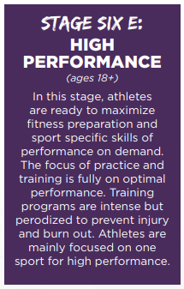
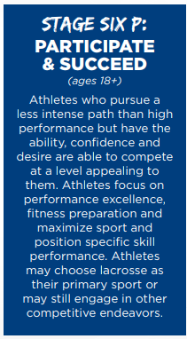
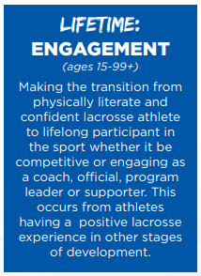
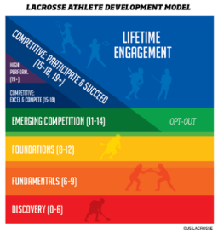
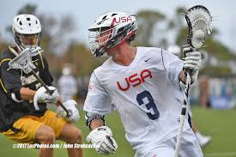
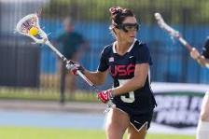
LADM – What is it?
STAGES of Development

Slide 9
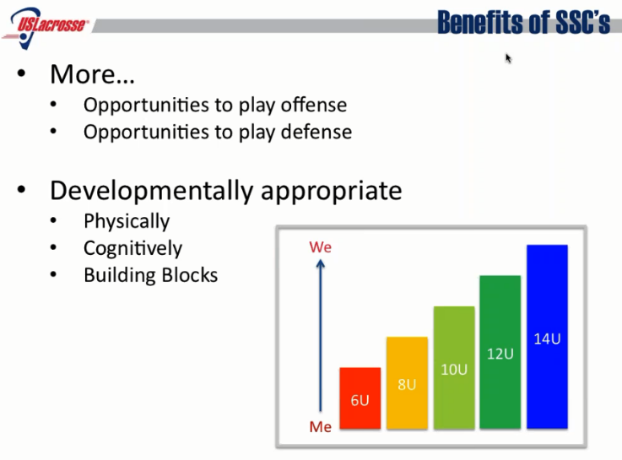
Why are we changing??

Slide 10
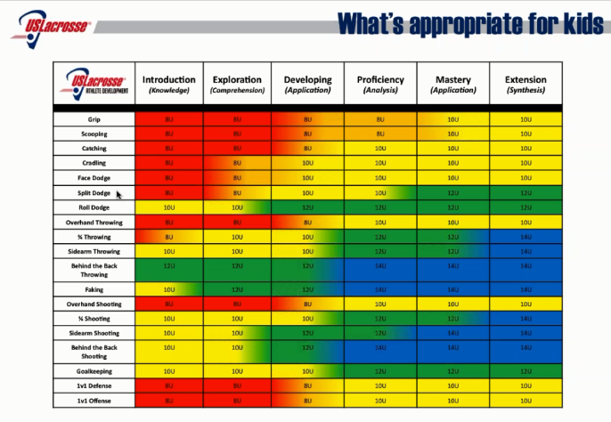
Why are we changing?

Slide 11
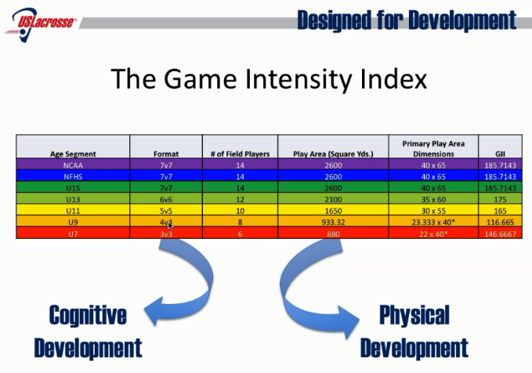
Why are we changing?

Slide 12
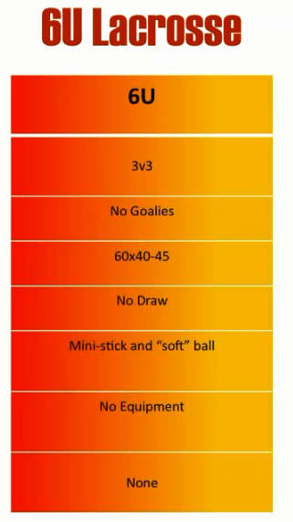
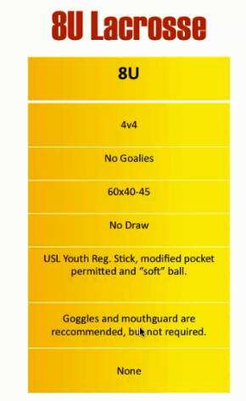
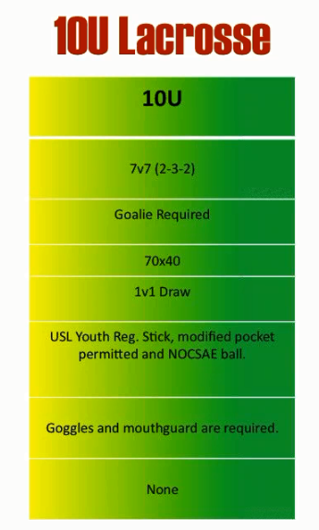
USLAX LADM Recommendations

Slide 13

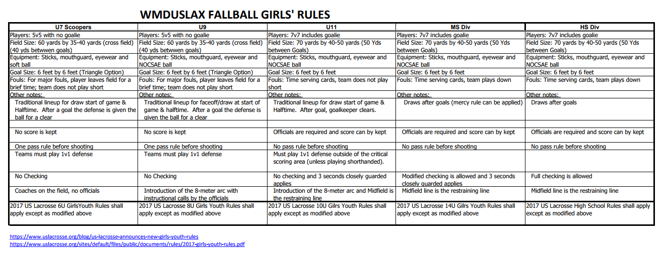
FallBall Rules Matrix

Slide 14
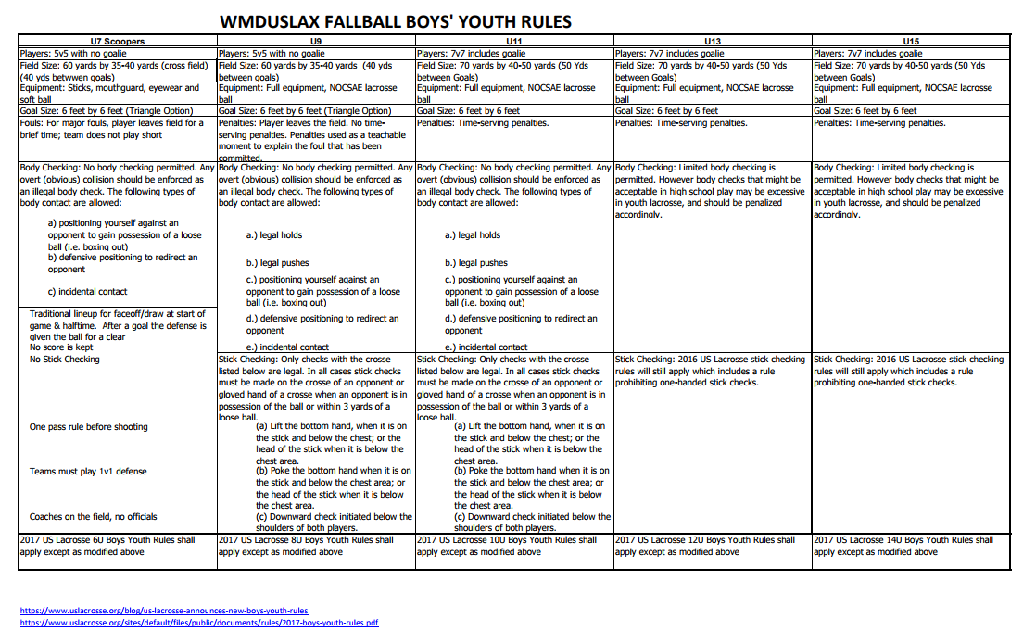
FallBall Rules Matrix

Slide 15

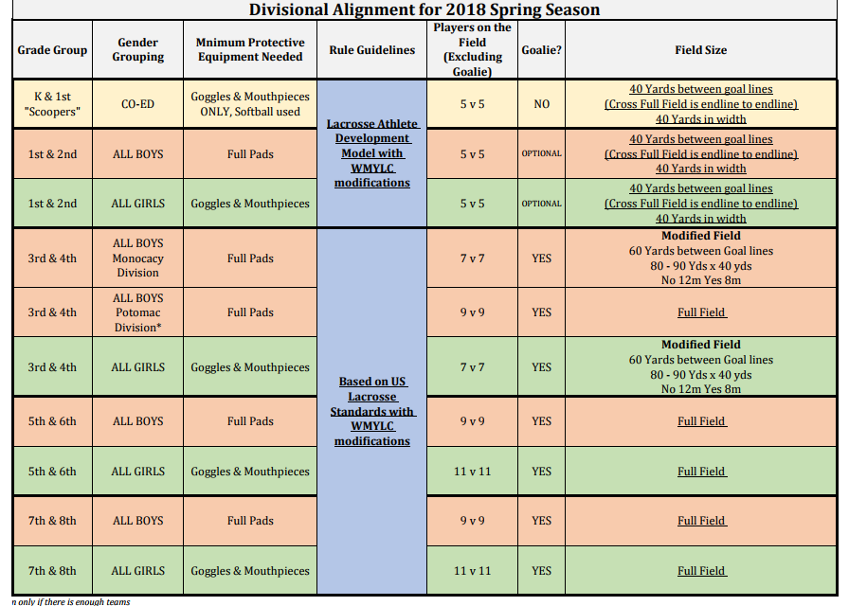
Rules Matrix

Slide 16
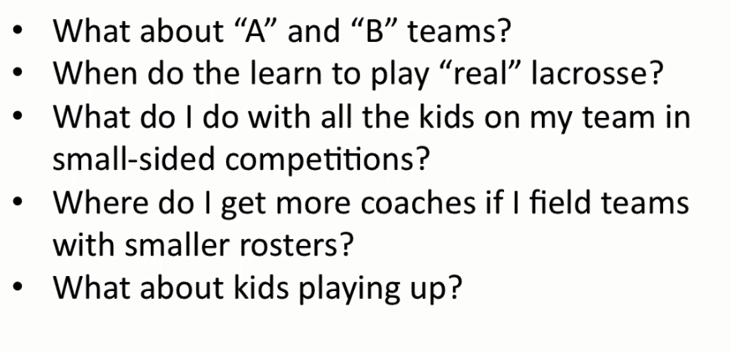
Common Concerns

Slide 17
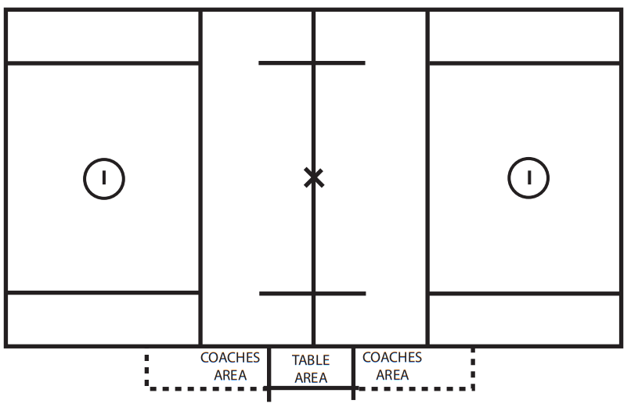
Common Concerns Where do I find More Fields?

Slide 18

Common Concerns Where do I find More Fields?

Slide 19
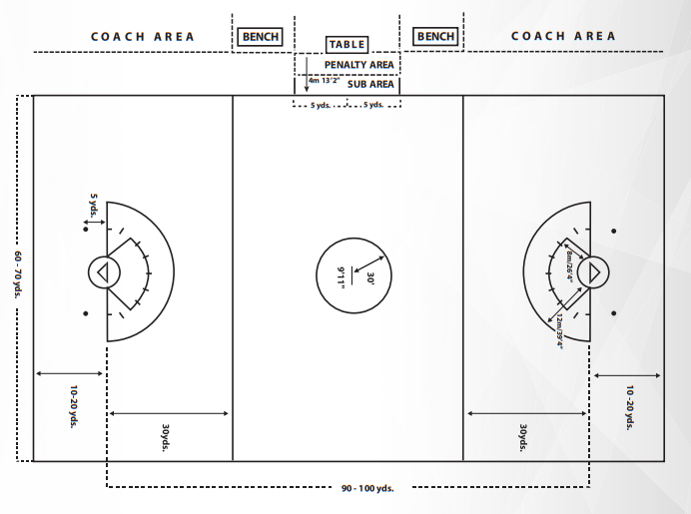

Common Concerns Where do I find More Fields?

Slide 20
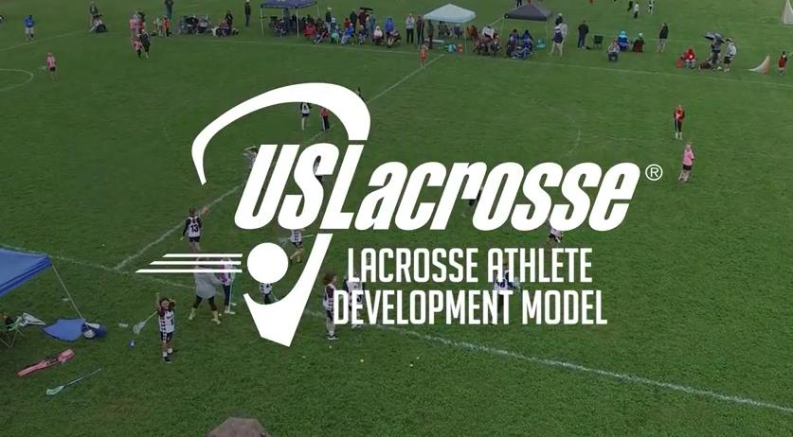
LADM in the Field
https://youtu.be/yAAviRq7SRo

Slide 21
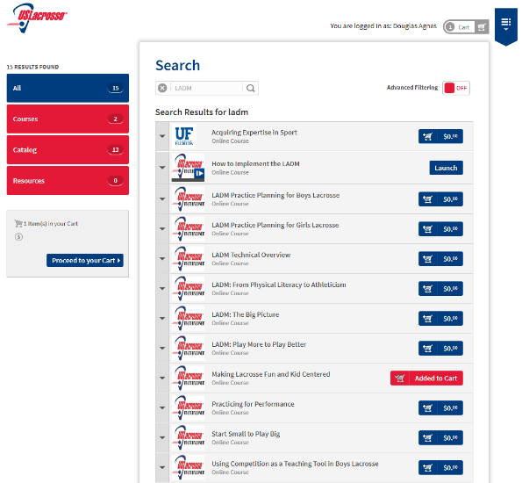
Where can I find out more??

Slide 22
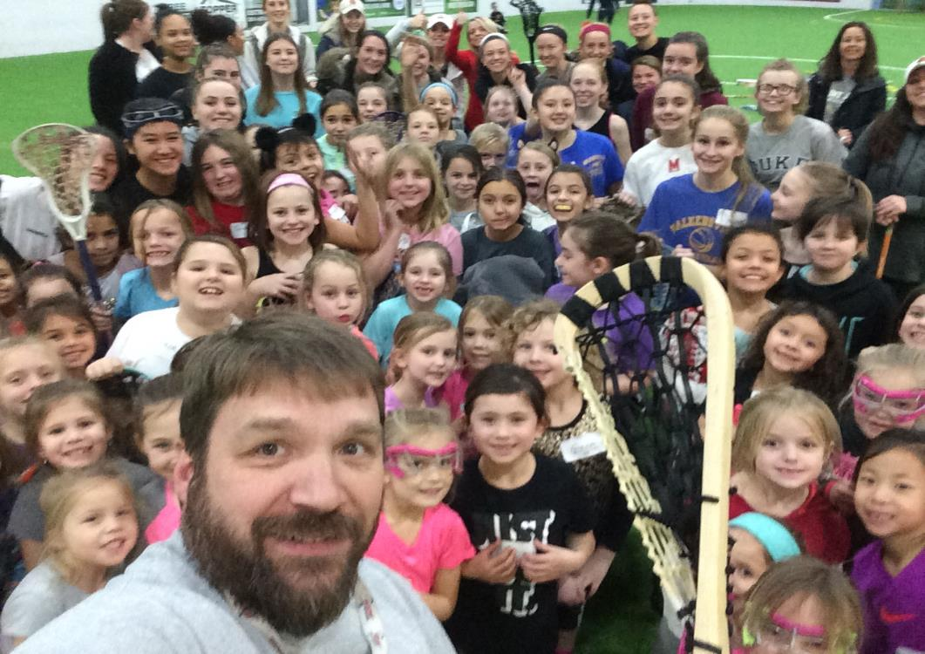
Questions ???
LADM The Right Lacrosse at the Right Time!

