Slide 1

New Officials Training

Slide 2
Agenda
Introductions
Schedules
Expectations
Arbiter & RefPay
Score / Time Keeper Training
Official Training – The Basics
Official Training – Game Management
Film

Slide 3
Schedule Coordinators & Game Day Contact Info
Dave Templeman - Director of Officials
Game Day Contact: 913-220-8326
Ebony Ewing: 1st – 6th floor scheduler
Game Day Contact: 574-904-6512
Zach Templeman: 7th – 12th floor scheduler
Game Day Contact: 816-316-9236
Rhonda Bailey: 1st – 6th table scheduler
Game Day Contact: 816-590-2078
Debbie Kilgore: 7th – 12th table scheduler
Game Day Contact: kilgorefour@gmail.com

Slide 4
Expectations
Uphold LSJBA principles of sportsmanship, character, cooperation, and teamwork.
Be at the gym 10 minutes before scheduled game time. DO NOT LEAVE until your replacement is there.
Referees - commit to getting better at your job every game. Learn something today. Keep learning.
Table – You are the legal score – talk to one another and make sure it’s right. NO PHONES!

Slide 5
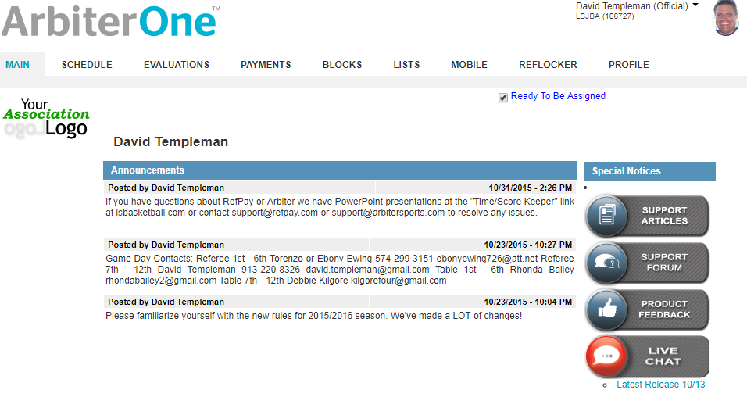
Arbiter Scheduling

Slide 6
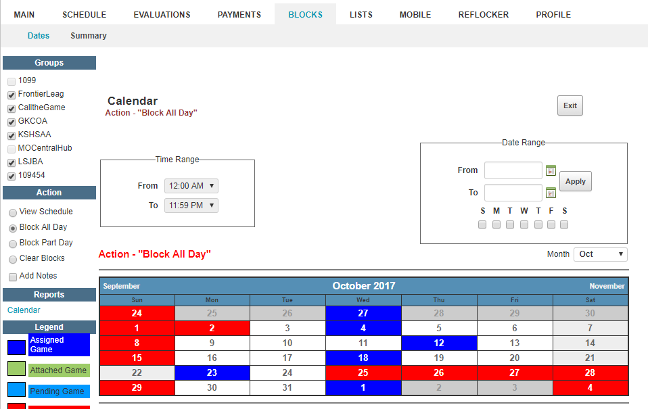
Block Your Schedule

Slide 7
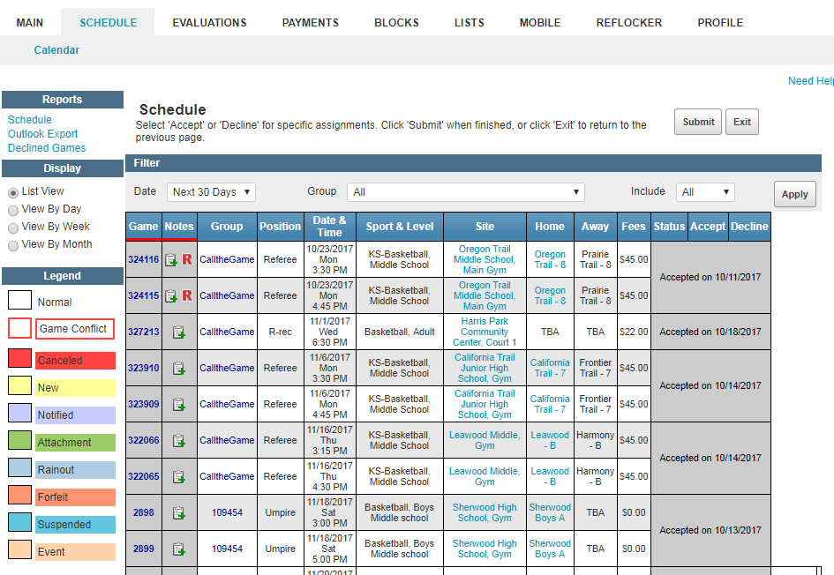
Accept Games / View Your Schedule

Slide 8
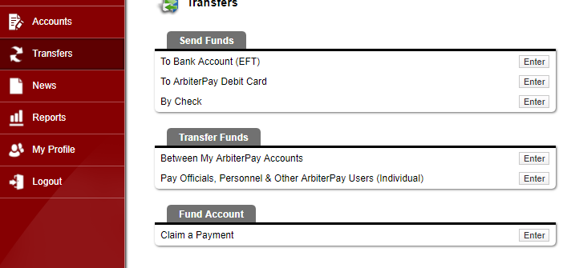
RefPay / ArbiterPay

Slide 9
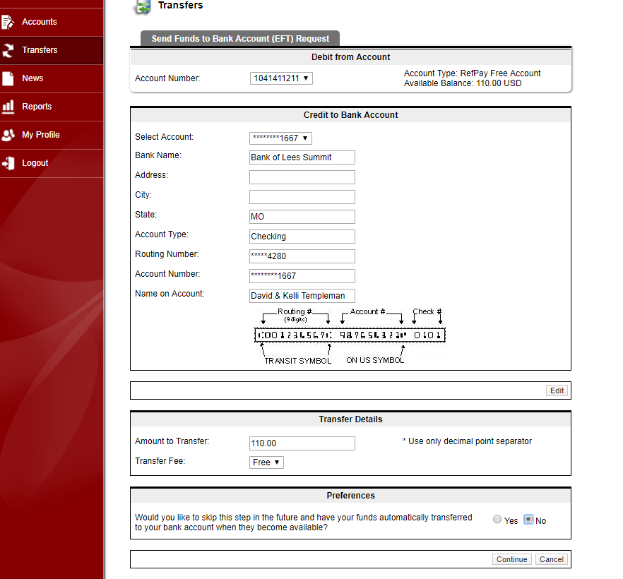
Get Paid

Slide 10
Arbiter / RefPay Help
OFFICIALS SUPPORT
Monday – Friday, 7:00 am to 7:00 pm MST
Email: support@arbitersports.com
Phone: 801-576-9436

Slide 11
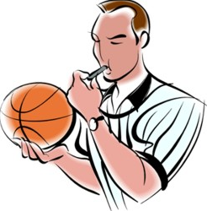
Referee Basics

Slide 12
Just Getting Started?
Start with the “Basic Three”
STRONG WHISTLE
OWN YOUR PRIMARY (No Ball Watching)
CALL THE FOULS

Slide 13
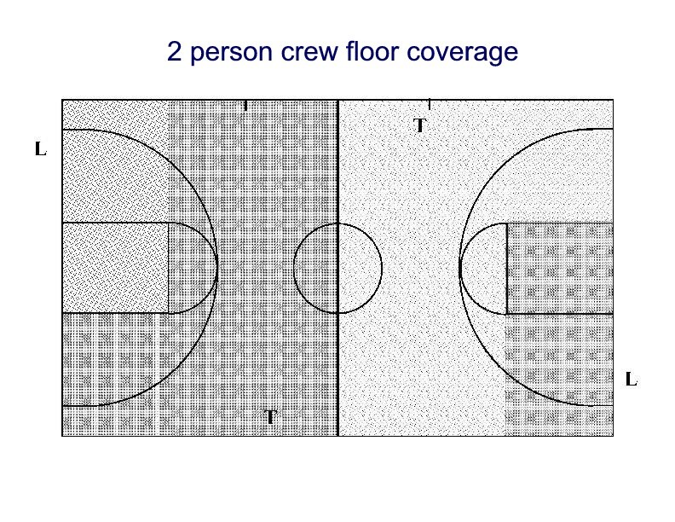
Primary Coverage Area (PCA)

Slide 14
Common Fouls / Violations in Younger Grades
Travel & Double Dribble: 1st / 2nd start season loose, tighten it up after holiday break. 3rd / 4th REC tighten it up game by game. Think “four step rule” (obvious travel)
Moving Screen: If there’s contact call the foul. Contact MUST occur to call a moving screen.
Bumping: Lots of kids come out of soccer into basketball. Bumping the ball handler is a foul.
“Reaching” Contact with the ball handler is a foul.

Slide 15
LSJBA Specific Rules
No Stealing 1st Grade / 2nd Grade prior to break.
Restrictions on Zone / Press Defense.
LSJBA Interpretation of Zone Defense.
Technical Fouls.

Slide 16
Game Management

Slide 17
Beyond the Basics
PRESENCE
MECHANICS
PROPER APPLICATION OF THE RULES
TERMINOLOGY
SITUATIONAL AWARENESS

Slide 18
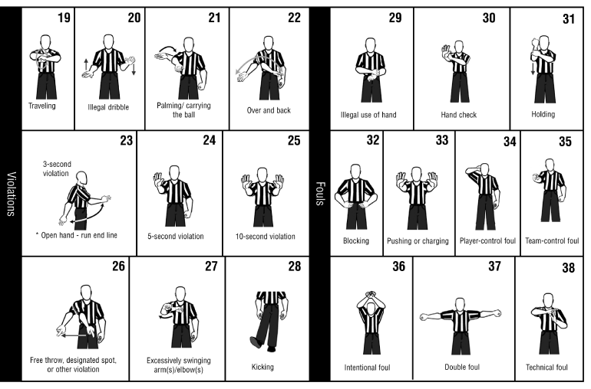
Mechanics
Be In Position

Slide 19
Beyond the Basics
Referee the Defense.
CONTACT IS A FOUL!
Held Ball Situations & dead ball officiating.
Communicate with your partner and the table.
Work on one thing to improve every game.
Have Fun!

Slide 20
Project Confidence
Communicate
Strong Whistle
Voice
Mechanics
Be In Position
Hustle
Know your Primary Coverage Area (PCA)

Slide 21
Dealing with Unsporting Behavior
You are responsible for maintaining order.
Composure & Professionalism at all times.
Watch for warning signs & deal with it early.
Use the Coach of the Day / LSJBA Staff.
“Two Technical Rule”
DO NOT ADDRESS UNRULY SPECTATORS DIRECTLY

Slide 22
REMEMBER…
Player Safety is our #1 Priority
SLOW DOWN
Communicate - Partner & Table
Use your Voice – players need help.

Slide 23
Film Study

Slide 24
Game Situations
OK State Regional Girls Final
Traveling
BackCourt?
Illegal Screen x’s 2
Block or Charge?
Who is this guy?!
Problem Children featuring Grayson Allen.
Problem Child
Intentional vs. flagrant contact.
Intentional vs. flagrant contact.
Intentional or Flagrant?

Slide 25
Maintaining Decorum
How not to deal with an irate bench.
Don't Allow This
This is not how to handle it.
Where’s the Gym Supervisor?
Where’s the Police?

