Slide 1

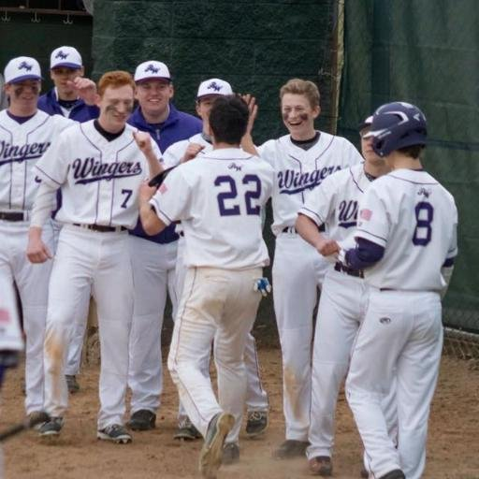
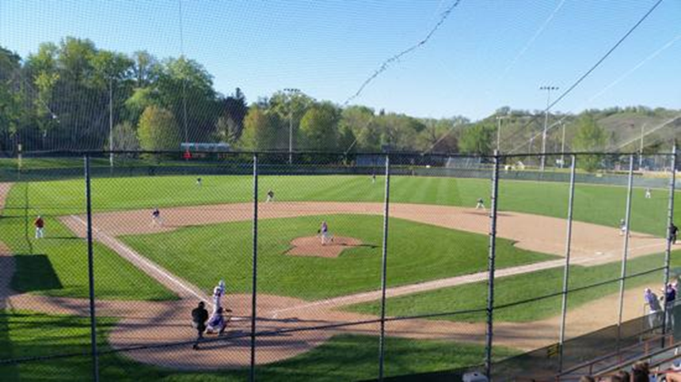
Winger Baseball 2017
Pre-Season Meeting

Slide 2
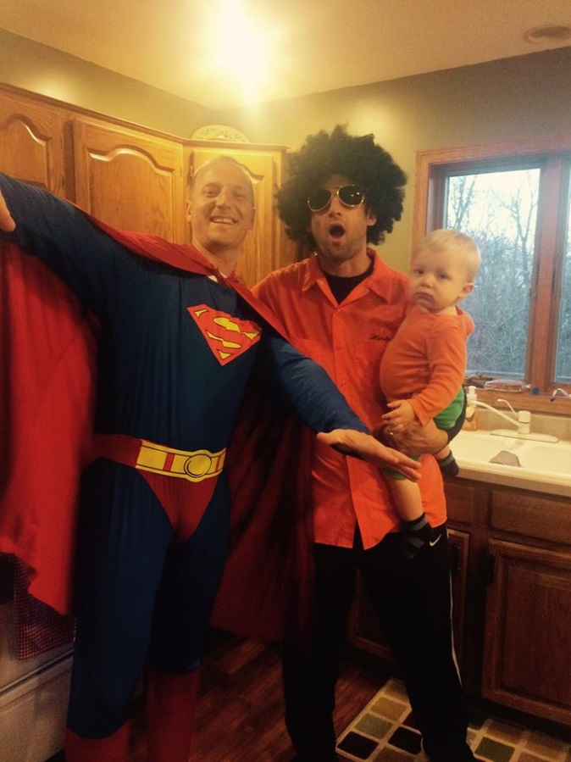
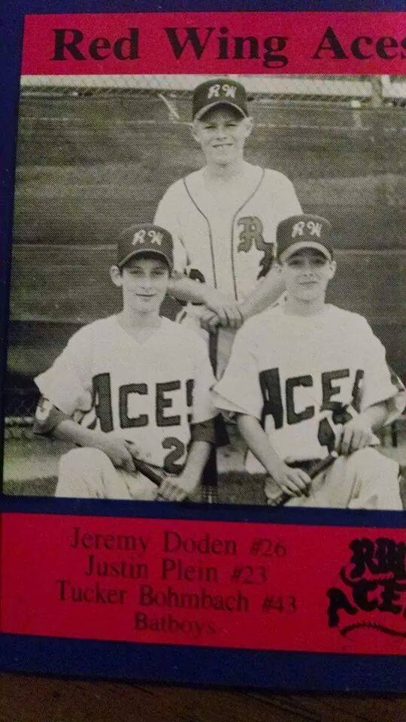
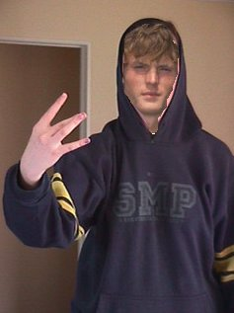
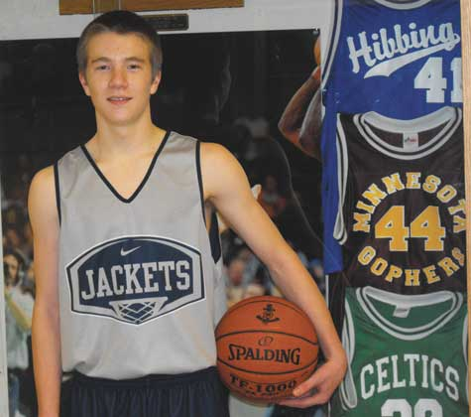
2017 Staff
Paul Hartmann – Varsity
Kyle Blahnik – Varsity
Chris Guetzlaff – Varsity
Justin Plein – JV
Patrick Milani– 9th Grade

Slide 3
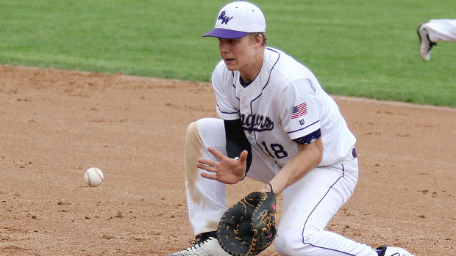
Practice – begins March 20
You MUST be registered by this Friday in order to practice Day 1.
Inside/outside. Be ready for both
What do I need?
All baseball items, including;
Spikes/Tennis Shoes
Long sleeves/sweatshirts/t-shirts
Practice pants
RW Hat – Last years…
J Band
Winter hats are ok to wear

Slide 4
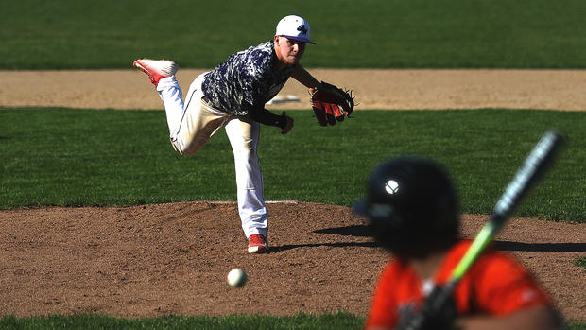
Practice Groups
For the first week of practice, we will have two practice groups.
This is subject to change based on weather – younger group less likely to change.
Practice to be held at the PI Arena, River Bluff HS and HS fields.
Group 1 (3:00 – 5:30)
Seniors, Juniors, some sophomores?
Group 2 (5:30 – 7:30)
Freshmen and sophomores

Slide 5
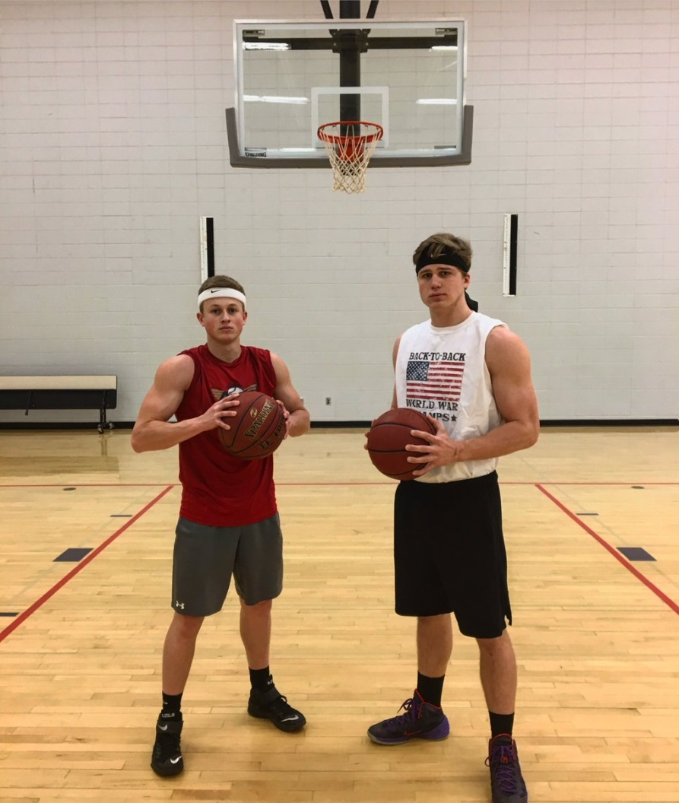
Info on website
http://www.gowingers.com/page/show/3155103-baseball-2017-
Remind…
9th Graders –
10th and 11th – JV and Varsity
12th – Varsity

Slide 6
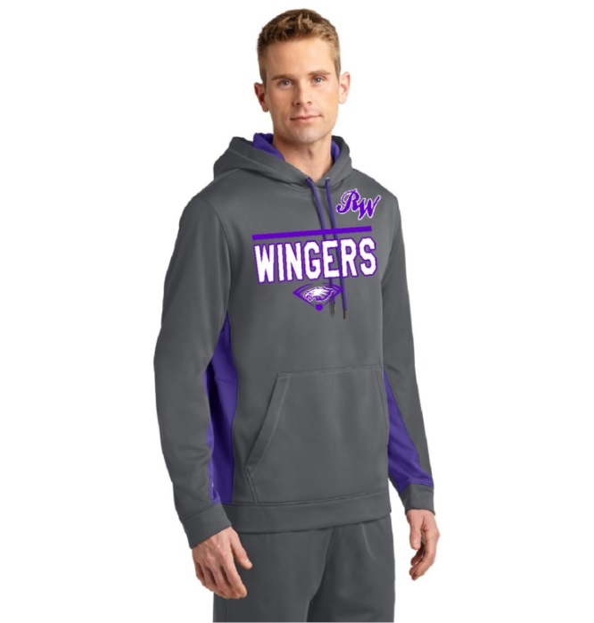
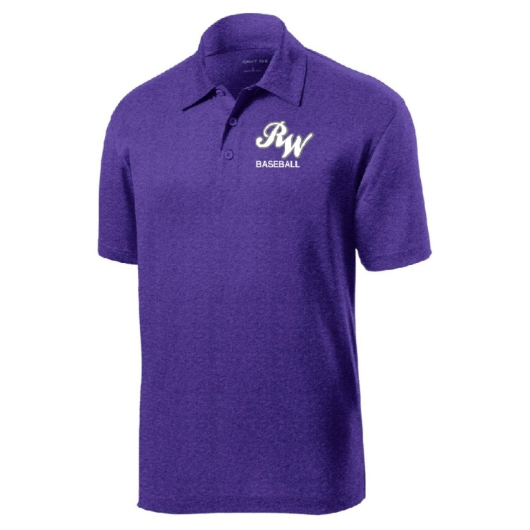
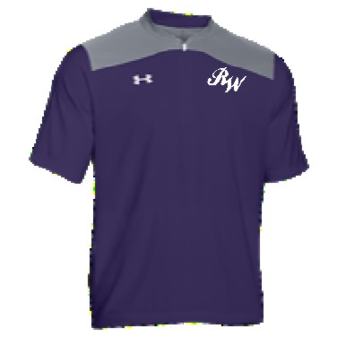
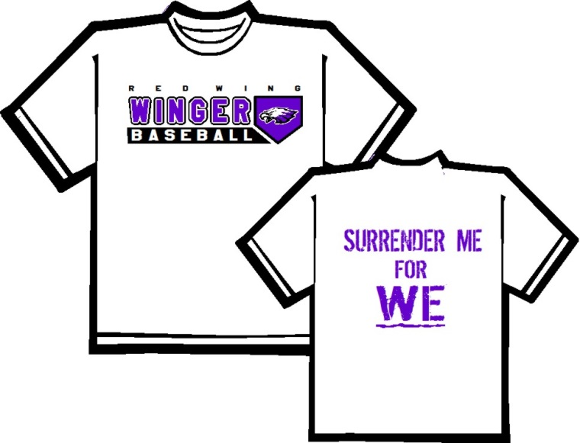
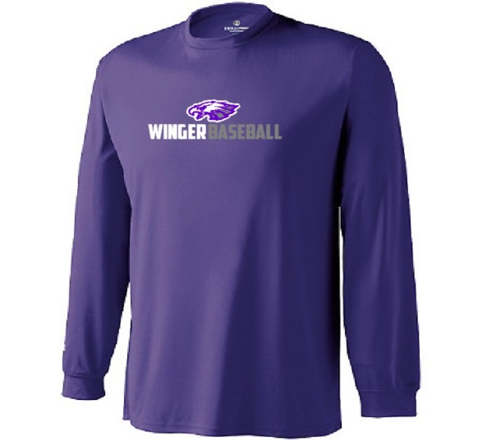
Apparel – Due Friday, 3/10 copies on website or coach blahnik

Slide 7
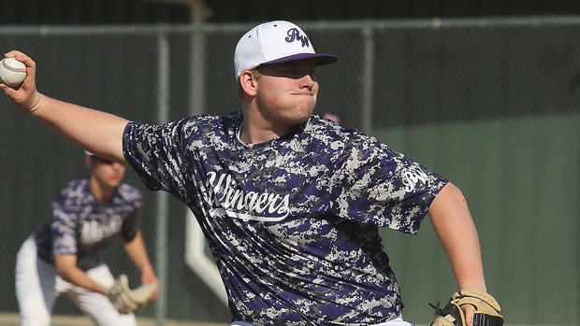
Winger Baseball Philosophy
Varsity Priority (in this order)
Understanding role relative to the TEAM
1. Competitiveness – “Play for the Pile”
2. Player Development
3. Participation
JV Priority (in this order)
Understanding role relative to the TEAM
1. Player Development
2. Participation
3. Competitiveness

Slide 8
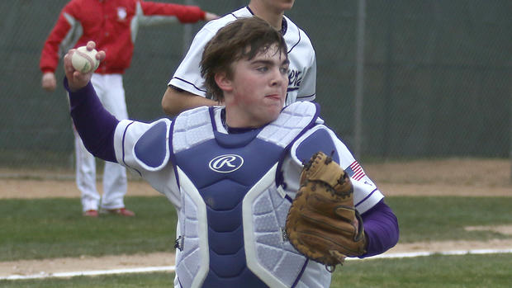
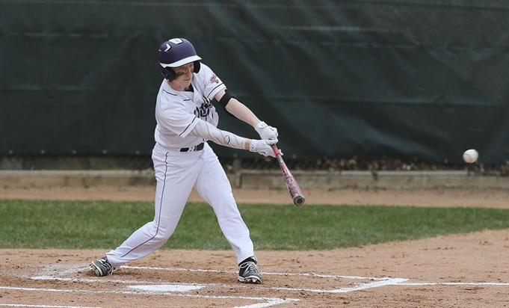
Winger Baseball Philosophy
9th Grade Priority (in this order)
Understanding role relative to the TEAM
1. Player Development
2. Participation
3. Competitiveness

Slide 9
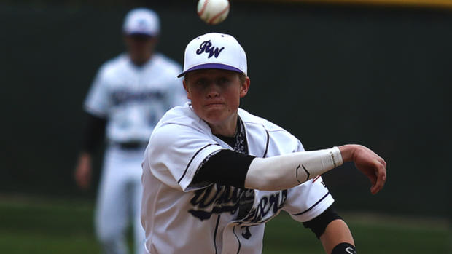
Varsity Roles
We have identified 20 roles throughout our season.
1. First Base 11. Starting Pitcher
2. Second Base 12. Reliever/Spot Starter
3. Third Base 13. Reliever/Spot Starter
4. Shortstop 14. Reliever/Spot Starter
5. Left Field 15. Reserve Catcher/Bullpen
6. Center Field 16. Reserve Mid-Infield/PR
7. Right Field 17. Reserve Corner Infielder
8. Catcher 18. Reserve Outfielder/PR
9. Starting Pitcher 19. LH Pinch Hitter / PR
10. Starting Pitcher 20. RH Pinch Hitter / PR
We will be keeping players in grades 9-12
who have earned 1 or more of these roles.

Slide 10
Varsity Roster
We have found that the ideal varsity roster size is 14-15
Some players will fill multiple roles
Multifaceted players allow us to keep roster size manageable (and playing time for everyone a reality).
The more things a player can do (field, hit, run, pitch) and the more positions they can play- the more they increase their chances of filling a roster spot.

Slide 11
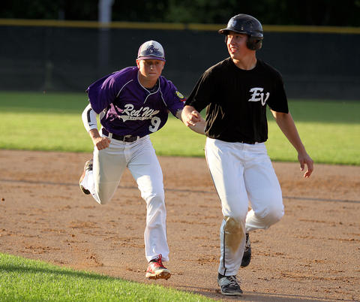
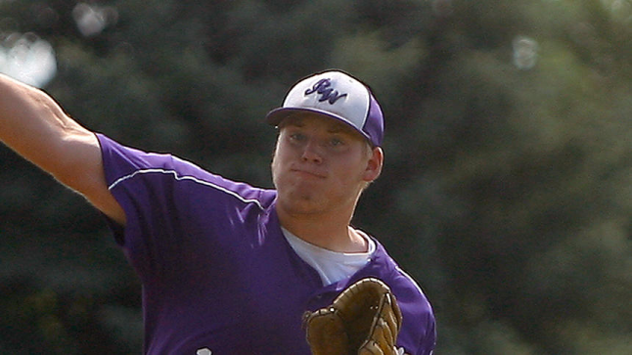
Summer baseball
Legion and VFW Baseball are an extension of our season.
Tryouts for these teams will take place from March 20 – May 21

Slide 12

Key points to remember:
1 – You must be signed up by the end of this week.
2 – Apparel sheets are due this Friday.
3 – You need to be signed up for Remind to receive important messages.
4 – You need to be ready for any type of practice day 1. Inside or outside.
5 – This is an outstanding program for a reason – take care of your stuff!

