Slide 1



Active Start practice plan
4 Corner concept
Hello , and welcome to this week session plan which design for coaches working with Active Start age . This is First stage of the grassroots level . We hope you enjoy this session plan. The focus for this stage should be providing a positive, and fun environment, concentration on ABC ( Agility, Balance, and Coordination), and basic soccer techniques.

Slide 2
Active Start practice plan
4 Corner concept
The activities provided , take a look at how stations are being used at the Grassroots level.
During the practice, players will spend an allotted time at each station having fun and developing specific skills before moving onto the next station. By using station work we ensure players are continually motivated and we can ensure that their attention is not lost.
At Active Start training session players will travel through 4 stations, one station focuses on general movements, one station on soccer coordination with the ball, one station on soccer technique and the final station focuses on a small sided soccer game which could be with mom or dad vs child 1v1.
All sessions take a holistic approach to developing our players. Each game and activity will take a look at how we can focus on 4 main areas of the child's development; these include Social/Emotional, physical, physiological and also technical
Total Practice time 30-45 minutes as per the OSA Recreational and Development Matrix.

Slide 3
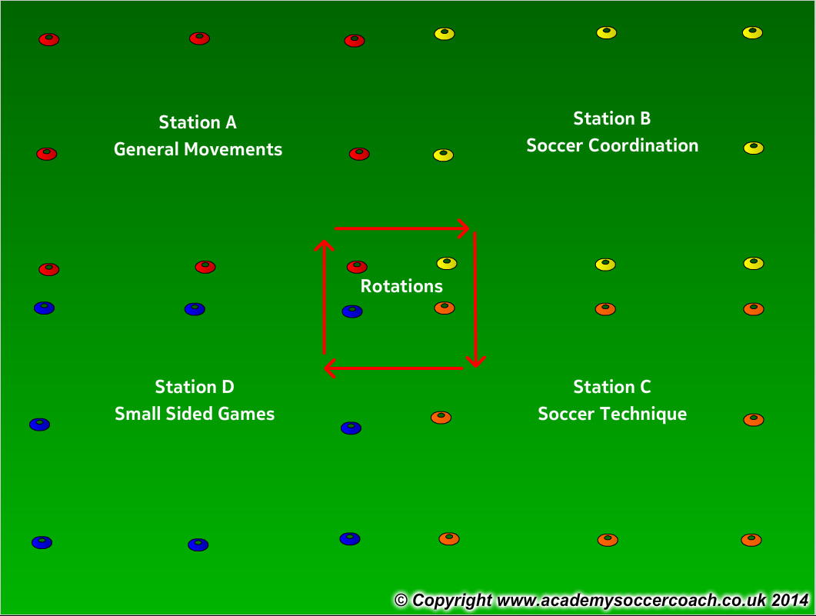
Active Start practice plan
How the 4 stations work
If working with a larger group organize players into groups of 8-10. Each station has a coach who will lead that specific station for the session. Players rotate every 6-8 minutes with a 2 minute break in between each station to have a water break and move to the next station.
If working with a smaller group you can still have the 4 stations and players will move together through all 4 stations until all are complete.
General movement %25
Coordination %25
Technique %25
SSG %25

Slide 4
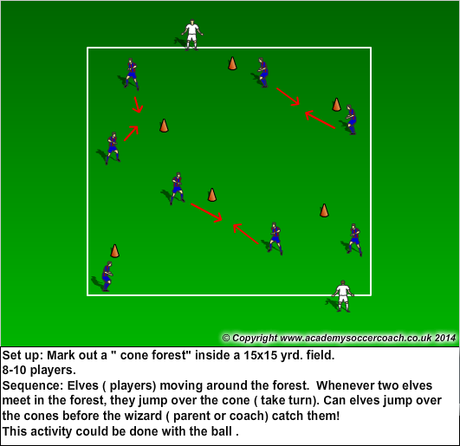
Active Start activities
General Movement
Elves and Wizard
Time frame.6- 8 minutes
Emphasis:
Running with/without the ball
Changing direction
Jumping
Awareness
Slowing down, speeding up
Fun
Psychological
Confidence
Being safe
Positive feedback
Technical
Running with the ball
Physical
A,B,C’s
Change of Direction
Social
Peer interaction
Communicating
Celebrating

Slide 5
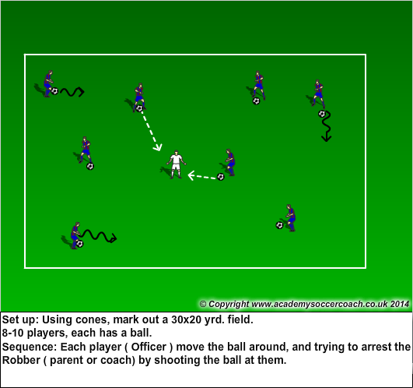
Active Start activities
Coordination
Catch the Robber!
Time frame. 6-8 minutes
Emphasis:
Eye – foot coordination
Lots of touches on the ball
Different parts of the foot
FUN!
Psychological
Positive reinforcement
Confidence
Being safe
Technical
Running with the ball Part of the ball, Part of the foot
Physical
Eye-hand coordination
Agility, Balance
Change of Direction
Social
Listening
Communicating
Celebrating

Slide 6
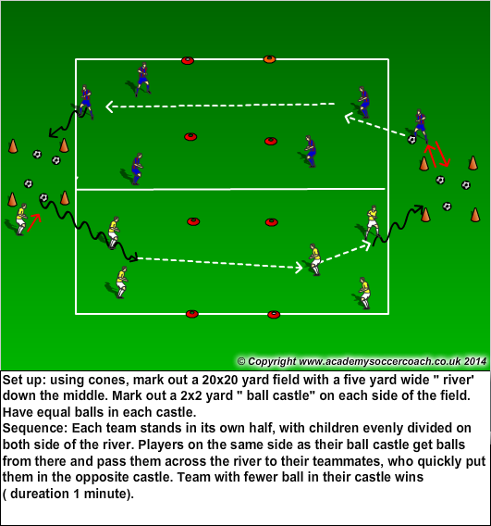
Active Start activities
Soccer technique
passing
Time frame.6- 8 minutes
Emphasis:
Lots of touches on the ball
Using different technique
Positive feedback
FUN!
Psychological
Positive reinforcement
Confidence
Being safe
Fun
Technical
Passing
Running with the ball
Physical
Speed
A,B,C’s
Change of Direction
Social
Communicating
Celebrating

Slide 7
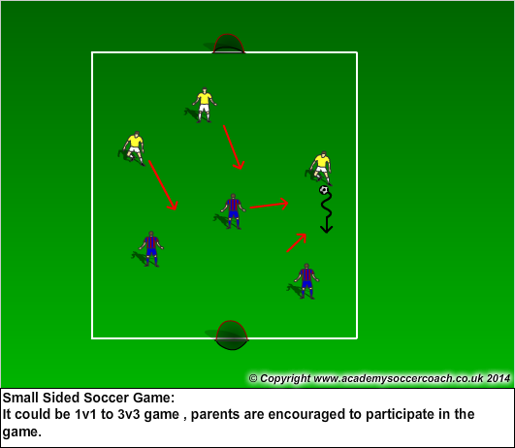
Active Start activities
Game
Time frame. 6-8 minutes
Emphasis:
Running with the ball
Dribbling
1v1
Changing direction
Change of speed
Agility, Balance, Coordination
Imagination
Passing
Fun
Psychological
Fun
Confidence
Being safe
Technical
Passing
Dribbling
1v1
Shooting
Physical
Speed
A,B,C’s
Change of Direction
Social
Peer interaction
Celebrating
Fin

