Slide 1
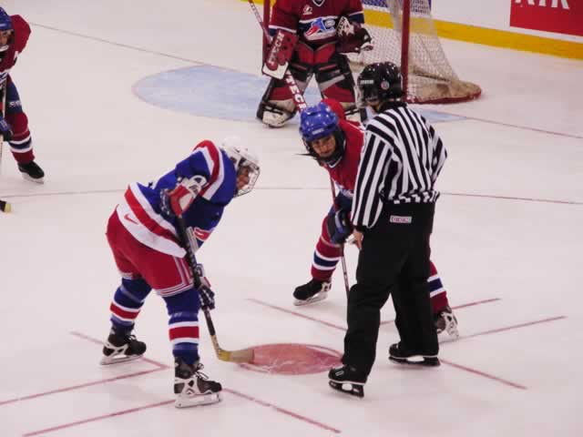

Face-Off Procedure Rule 10.2 pg. 125

Slide 2
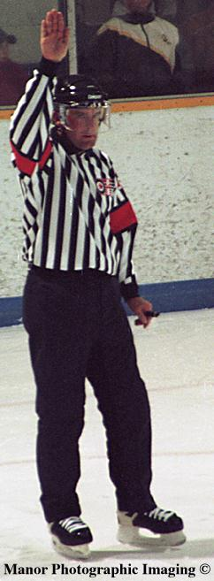
Face Off Procedures
When the referee’s doing his line change procedure, the linesman must make sure that the number of players on the ice is correct.

Slide 3
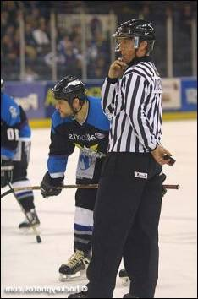
Face Off Procedures
When the referee drops his arm, the linesman blows the whistle and the players have 5 seconds to be ready.

Slide 4
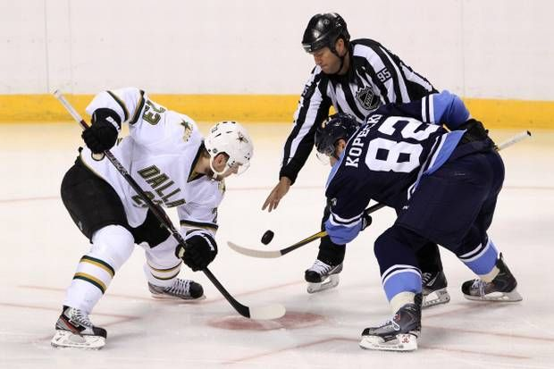
Face Off Procedures
During that 5 seconds, he makes sure of the player’s positioning.
Give clear instructions.

Slide 5
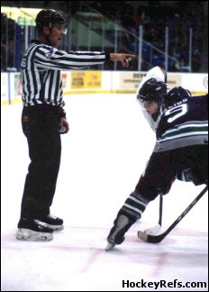
Face Off Procedures
Check the position of the players in front of you.
The back linesman checks the players behind.

Slide 6
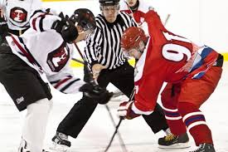
Face Off Procedures
Check your partner to be sure they are ready.
Check if the goalie is ready.
The skates have to be inside the L mark.
Do the face-off !

Slide 7
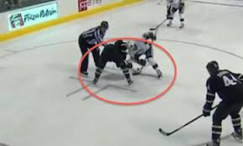
Face Off Procedures
What happens if there is a violation of any of these rules?

Slide 8
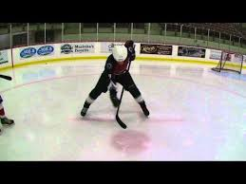
Encroachment
Rule 10.2 (c) pg. 125

Slide 9
Encroachment
Centers must lineup with their feet outside of the restraining lines
Stick must be on the ice and not moving, with the tip in the white area of the face-off dot.

Slide 10
Encroachment
Other players must line up with their skates and bodies outside of the face-off circle - on the line is considered in the circle
They must also keep their sticks, skates, and bodies completely on their side of the hash marks.

Slide 11
What goes where?
Sticks and Skates
Sticks and Skates
Sticks, No Skates
No sticks, no skates
Sticks, No Skates
Sticks and Skates
Sticks and Skates

Slide 12
Encroachment
If center does not line up properly for the face-off they are removed
If winger or defenseman encroaches, remove center
Player that encroached is not allowed to take face-off.

Slide 13
Encroachment
On the way in coach them, tell them “feet outside of the lines, stick in the white, don’t move”; by doing this it will speed up your face-offs
Be consistent with encroachment from the first to last face-off.

Slide 14

Where’s the
?

Slide 15
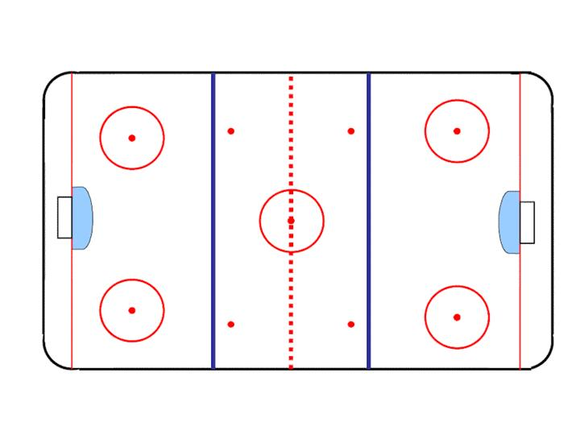
1. Team A shoots the puck out of bounds
1
2
3
4
A
B
9
5
8
6
7
Notes:
This slide will animate the process of the end zone faceoff after a whistle. The puck will be held by the goalie, the whistle will blow, the officials will come in to make sure there are no issues, and then proceed to pick up the puck and the other official will go to do line change procedure. The official in the neutral zone will point to the other official when the line change is completed, the official dropping the puck will blow the whistle and complete the face-off sequence.

Slide 16
1. Team A shoots the puck out of bounds
1
2
3
4
A
B
9
5
8
6
7
Notes:
This slide will animate the process of the end zone faceoff after a whistle. The puck will be held by the goalie, the whistle will blow, the officials will come in to make sure there are no issues, and then proceed to pick up the puck and the other official will go to do line change procedure. The official in the neutral zone will point to the other official when the line change is completed, the official dropping the puck will blow the whistle and complete the face-off sequence.

Slide 17
2. Team A shoots the puck out of bounds
1
2
3
4
A
B
9
5
8
6
7
Notes:
This slide will animate the process of the end zone faceoff after a whistle. The puck will be held by the goalie, the whistle will blow, the officials will come in to make sure there are no issues, and then proceed to pick up the puck and the other official will go to do line change procedure. The official in the neutral zone will point to the other official when the line change is completed, the official dropping the puck will blow the whistle and complete the face-off sequence.

Slide 18
2. Team A shoots the puck out of bounds
1
2
3
4
A
B
9
5
8
6
7
Notes:
This slide will animate the process of the end zone faceoff after a whistle. The puck will be held by the goalie, the whistle will blow, the officials will come in to make sure there are no issues, and then proceed to pick up the puck and the other official will go to do line change procedure. The official in the neutral zone will point to the other official when the line change is completed, the official dropping the puck will blow the whistle and complete the face-off sequence.

Slide 19
3. Team A player passes the puck, creating an offside at the blue line
1
2
3
4
A
B
9
5
8
6
7
Notes:
This slide will animate the process of the end zone faceoff after a whistle. The puck will be held by the goalie, the whistle will blow, the officials will come in to make sure there are no issues, and then proceed to pick up the puck and the other official will go to do line change procedure. The official in the neutral zone will point to the other official when the line change is completed, the official dropping the puck will blow the whistle and complete the face-off sequence.

Slide 20
3. Team A player passes the puck, creating an offside at the blue line
1
2
3
4
A
B
9
5
8
6
7
Notes:
This slide will animate the process of the end zone faceoff after a whistle. The puck will be held by the goalie, the whistle will blow, the officials will come in to make sure there are no issues, and then proceed to pick up the puck and the other official will go to do line change procedure. The official in the neutral zone will point to the other official when the line change is completed, the official dropping the puck will blow the whistle and complete the face-off sequence.

Slide 21
4. Team A player passes the puck, creating an offside at the blue line
1
2
3
4
A
B
9
5
8
6
7
Notes:
This slide will animate the process of the end zone faceoff after a whistle. The puck will be held by the goalie, the whistle will blow, the officials will come in to make sure there are no issues, and then proceed to pick up the puck and the other official will go to do line change procedure. The official in the neutral zone will point to the other official when the line change is completed, the official dropping the puck will blow the whistle and complete the face-off sequence.

Slide 22
4. Team A player passes the puck, creating an offside at the blue line
1
2
3
4
A
B
9
5
8
6
7
Notes:
This slide will animate the process of the end zone faceoff after a whistle. The puck will be held by the goalie, the whistle will blow, the officials will come in to make sure there are no issues, and then proceed to pick up the puck and the other official will go to do line change procedure. The official in the neutral zone will point to the other official when the line change is completed, the official dropping the puck will blow the whistle and complete the face-off sequence.

Slide 23
5. Team A hand pass
1
2
3
4
A
B
9
5
8
6
7
Notes:
This slide will animate the process of the end zone faceoff after a whistle. The puck will be held by the goalie, the whistle will blow, the officials will come in to make sure there are no issues, and then proceed to pick up the puck and the other official will go to do line change procedure. The official in the neutral zone will point to the other official when the line change is completed, the official dropping the puck will blow the whistle and complete the face-off sequence.

Slide 24
5. Team A hand pass
1
2
3
4
A
B
9
5
8
6
7
Notes:
This slide will animate the process of the end zone faceoff after a whistle. The puck will be held by the goalie, the whistle will blow, the officials will come in to make sure there are no issues, and then proceed to pick up the puck and the other official will go to do line change procedure. The official in the neutral zone will point to the other official when the line change is completed, the official dropping the puck will blow the whistle and complete the face-off sequence.

Slide 25
6. Team A hand pass
1
2
3
4
A
B
9
5
8
6
7
Notes:
This slide will animate the process of the end zone faceoff after a whistle. The puck will be held by the goalie, the whistle will blow, the officials will come in to make sure there are no issues, and then proceed to pick up the puck and the other official will go to do line change procedure. The official in the neutral zone will point to the other official when the line change is completed, the official dropping the puck will blow the whistle and complete the face-off sequence.

Slide 26
6. Team A hand pass
1
2
3
4
A
B
9
5
8
6
7
Notes:
This slide will animate the process of the end zone faceoff after a whistle. The puck will be held by the goalie, the whistle will blow, the officials will come in to make sure there are no issues, and then proceed to pick up the puck and the other official will go to do line change procedure. The official in the neutral zone will point to the other official when the line change is completed, the official dropping the puck will blow the whistle and complete the face-off sequence.

Slide 27
7. Team B hand pass
1
2
3
4
A
B
9
5
8
6
7
Notes:
This slide will animate the process of the end zone faceoff after a whistle. The puck will be held by the goalie, the whistle will blow, the officials will come in to make sure there are no issues, and then proceed to pick up the puck and the other official will go to do line change procedure. The official in the neutral zone will point to the other official when the line change is completed, the official dropping the puck will blow the whistle and complete the face-off sequence.

Slide 28
7. Team B hand pass
1
2
3
4
A
B
9
5
8
6
7
Notes:
This slide will animate the process of the end zone faceoff after a whistle. The puck will be held by the goalie, the whistle will blow, the officials will come in to make sure there are no issues, and then proceed to pick up the puck and the other official will go to do line change procedure. The official in the neutral zone will point to the other official when the line change is completed, the official dropping the puck will blow the whistle and complete the face-off sequence.

