Slide 1
Welcome MAHA Summer Meeting 2016
Building Foundations for Growth!

Slide 2
Presidents Report
Building Foundations for Growth!

Slide 3
USA Hockey Player Growth
Notes:
USA Down .18%

Slide 4
USA Hockey Player Registration
All Players
Minnesota – 57,107
Michigan – 50,022
New York – 49,921
Massachusetts – 49,087
Illinois – 31,558
Youth Players
Minnesota – 47,367
Massachusetts – 44,035
New York – 35,535
Michigan – 26,770
Illinois – 22,507
Notes:
All Players Up 2.65 %

Slide 5
USA Hockey Player Registration
Youth Players
Minnesota – 47,367
Massachusetts – 44,035
New York – 35,535
Michigan – 26,770
Illinois – 22,507
8U Players
Minnesota – 17,651
Massachusetts – 13,098
New York – 10,776
Michigan – 7,289
Wisconsin – 5,793
Notes:
All Players Up 2.65 %

Slide 6
The Only Registration Trend That Matters – 8U
Notes:
Nationally 8U up 1.2%
Up 139 Players or 1.8%
8U Needs to be 20% of your association number

Slide 7
District Player Registration Trends
Notes:
D3 only district with increase

Slide 8
Michigan Birth Rate

Slide 9
Greatest Increase of 8U Players
District 2 – Allen Park 70
District 3 – Grosse Pointe / St Clair Shores 16 Each
District 4 – Compuware 47
District 5 – Port Huron 53
District 6 – Kalamazoo 81 (290 8U Players)
District 7 – Cadillac / Soo 6 each
District 8 – Iron Amateur 16

Slide 10
Consistent Program Development Number of 8U Players 2006-07 vs 20015-16
District | Association | 2006-07 | 2015-16
District 2 | Garden City | 36 | 93
District 3 | St. Clair Shores | 104 | 125
District 4 | Orchard Lake United | 55 | 82
District 5 | Midland | 157 | 201
District 6 | Chelsea | 47 | 167
District 7 | Grand Traverse | 157 | 177
District 8 | Iron Range | 57 | 68

Slide 11
2 & 2 Challenge
39 Associations Achieved Awards ( Same as Previous Year 42.4%)
Gold – 29
Silver - 4
Bronze – 6
We have a ways to go to be #1 – Wisconsin 51 of 83 Associations 61.4% Participation

Slide 12
USA Hockey Initiatives
Try Hockey For Free
November 12, 2016
February 25, 2017
Free Registration for This Event Again
Hockey Weekend Across America
10th Anniversary
Expanding to a Week Long Celebration
February 19 – 26, 2017

Slide 13
Mite Hockey Enhancements and Support for 15 -16
Grant Support For Proper Equipment
Over $75,000 in Grants for 15-16
Leagues Started To Provide More Competition Options
High Performance Training
3 Six Week Sessions With 110 Participants
Reached Out to Experts For Endorsements
Series of 10 Videos Created With Top Michigan Coaches

Slide 14
Mite Hockey Enhancements and Support for 15 -16
Association Tool Box
Kit Sent to Every Association in Early Fall
Mite Half-Ice Ice State Championship Started
65 Team Participated in 3 Divisions

Slide 15
MAHA Sponsored Mite Jamborees
2016 - 2017 Jamboree Dates
December 10, 2016 – Polar Palace Lapeer
January 28, 2017 - Location TBD
February 18 – 19, 2017 - Center Ice - Traverse
MAHA State Championship
March 4 - 5, 2017 - Location TBD

Slide 16
MAHA High Performance Development Program
To provide additional training opportunities for players, while having coaches experience the latest methods in high performance age appropriate drills, coaching techniques and practice formats.
Mites - PeeWees
Nine Dates From October To February
Associations Sign Up to Participate
Time Late Afternoon on Saturday – See the National Team Play That Night (Optional)

Slide 17
Flex Hockey
Tailor Programs to Your Local Need
Purely for FUN and Recreation
Low Time Commitment / $$$$$
Introductory Program or Second Sport
From Small Area Games to Full-Ice
Checking Optional at 14U and Up
Team Can Be Built on Skill Not Age
Minimal Coaching Requirements

Slide 18
Task Force 2018
Support Growth
Proper Development
Provide Better Experience
Support Associations
Eliminate or Change Rule/Costs

Slide 19
Club Excellence
Increased Association Support & Training
On-Line Support
New Portal for Association Boards is Launching Soon
All Association Need to be On Board
Other Support
More Meeting Content Geared Toward Association Education / Issues
Support for More Efficient, More Secure Paperless Flow of Forms

Slide 20
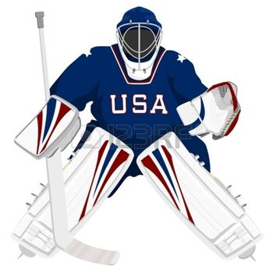
Goaltending Development Coordinator
Educate and facilitate clubs and associations in implementing a Goaltending Development Curriculum. Including providing Coaching Coaches Clinics, coaching materials and support.

Slide 21
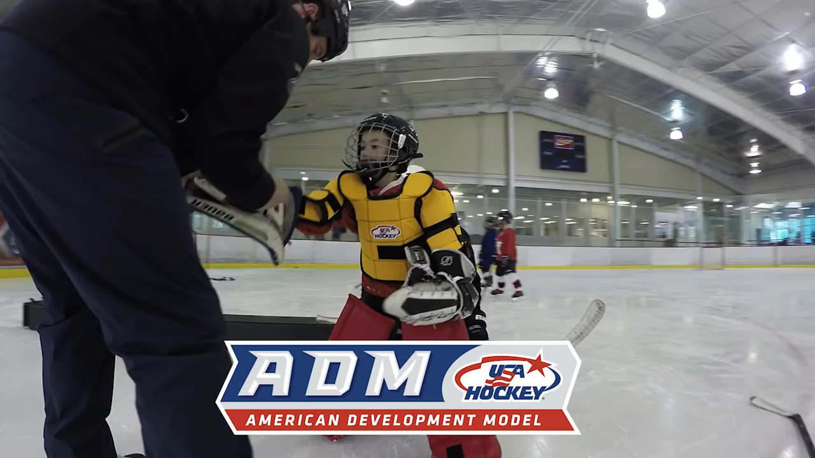
Quick Change Goalie Pads
New for 2017
Order on line by July 15 for Early November Delivery
Cost $189 = Shipping
MAHA Grant Program
$100 per set (up to 2 sets) for each association
Reimbursement through OneGoal Program

Slide 22
Other Initatives
Special Committee Director Election
Kim Durka – Chair
Doug Diroff, Jean Laxton, Jerry Ludden, Bob De Spirit, Steve Stapleton, Joe Baronne, Perry Wooden
Financial Obligations Policy
USA Hockey passed broad guidelines in June
Committee being formed to draft Michigan policy

Slide 23
USA Hockey Proud (Cick Image to start video)

Slide 24
Welcome MAHA Summer Meeting 2016
Building Foundations for Growth!

