Slide 1
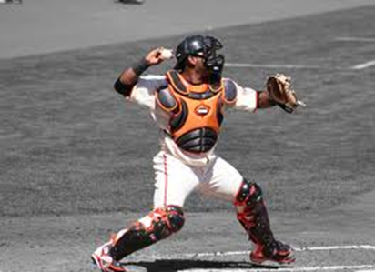


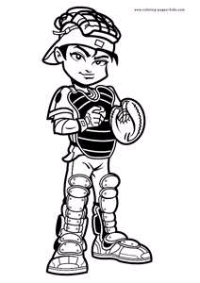
Hopkins Baseball Coaching Clinic
Catching Instructional

Slide 2
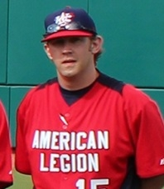





Speaker: Todd Jahnke
COACHING EXPERIENCE
Head Baseball Coach (2005-Current)
Hopkins Flyers, Post #320 American Legion Baseball
Assistant Coach (2012-Current)
American Legion/ Team USA Tournament of Stars
Assistant Coach (2005-2011)
Concordia St. Paul University Golden Bears
Head Baseball Coach (2008-2010)
University of Minnesota Siebert Fall Instructional League
Hopkins Diamond Club Member (2008-Current)
Player Development – Summer Program
Instructor, Lunch McKenzie’s Baseball USA School (2005-2011)
Taught hundreds of private lessons and group clinics
Assistant Coach (2003-2005)
Excelsior Fire Club, Post #259 American Legion Baseball
Assistant Coach (2001-2005)
Hopkins Millers, Mickey Mantle Baseball
PLAYING EXPERIENCE
Hopkins Berries Amateur Baseball (1999-2008)
St. John’s University (1999-2003)
Hopkins Royals / Hopkins Legion (1996-1999)

Slide 3
Presentation Outline
DEFENSIVE FUNDAMENTALS OF A CATCHER
  1. Stance
  2. Receiving
  3. Blocking
  4. Throwing
CATCHER-PITCHER RELATIONSHIP
MENTAL MAKE-UP OF A GOOD CATCHER
THE ART OF CALLING A GAME (PITCH SELECTION)
QUESTIONS / COMMENTS
}
Listed in order of importance

Slide 4
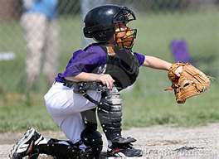
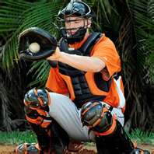
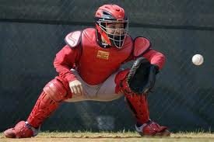
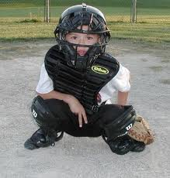
Defensive Fundamentals
STANCE
“The Solid Foundation of Catching”
Sound & Solid Foundation (Balanced Base)
  Feet should be equal to or wider than shoulders
Runners on base stance and/or 2 strikes on the hitter
No Runners on base stance
Throwing Hand Position
Relaying Signs to Pitcher (Positioning)
Relaxed,
No runners on base
Ready! Solid foundation!
Runners on base
Cute, but dangerous!
Impressive!

Slide 5
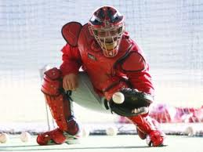
Defensive Fundamentals
RECEIVING
“If you can’t catch the ball, you can’t be a catcher”
Proper Body Control
Body: Get LOW, giving the umpire the optimal view of the strike zone
Glove-Hand Arm: Elbow bent and positioned at 45-degree angle
Glove-Hand Fingers: Pointer finger positioned at 12-o’clock, thumb at 2-o’clock
Throwing Arm: With runners on base, hand MUST be out in the open
Proper Receiving Technique
Move to location quietly and just prior to pitcher to locating target
Keep target just below knee level (in most cases)
Try to center everything on chest (within reason)
“Frame” strikes ONLY
Discuss “framing” strikes by zone (steering wheel)
Glove control, strong wrists
“Drop-knee framing”
“It’s all about presentation and perception”
Louisville Univ_Catcher Receiving

Slide 6

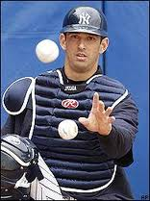
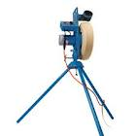
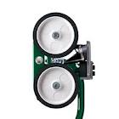
Defensive Fundamentals
RECEIVING DRILLS
“If you can’t catch the ball, you can’t be a catcher”
Soft-Hands Drill (Framing)
Pitching Machine Drill
Have Catcher get into stance
Incorporate rotation of 8-10 baseballs
Firmly and rapidly underhand baseballs to catcher
Have your Catcher correctly receive baseballs in each strike zone with soft hands, framing each strike, with as little wrist movement as possible
GOAL: To practice and perfect receiving techniques
in all strike zones.
A pitching machine allows you to accurately replicate live pitches in any part of the strike zone. Using a pitching machine allows you to focus your attention on any desired location, speed, and pitch type.
GOAL: To practice and perfect receiving techniques
in all strike zones.

Slide 7
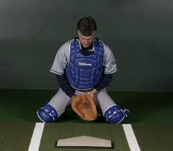
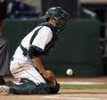
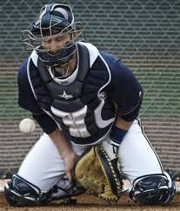
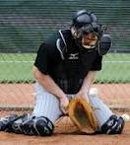
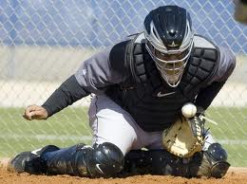
Defensive Fundamentals
BLOCKING
“Saving bases, saves ballgames”
Sound & Solid Foundation (Base)
Pitch recognition (out of pitcher’s hand)
“Plan” to receive, “Expect” to block
Movement required in straight on block
Movement required in blocking balls to the left/right
Cover up the “5-Hole”
What to do with the throwing hand
Tilted Chest (square up the ball), Tucked Chin
Louisville Univ. Catcher Blocking Drills

Slide 8
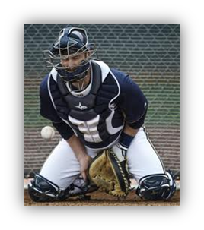
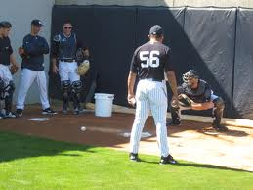
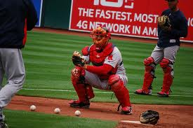
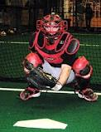
Defensive Fundamentals
BLOCKING DRILLS
“Saving bases, saves ballgames”
Three-Ball (Technique) Drill
Receiving vs. Blocking Drill
Set up 3 balls (right, center, left).
Instruct player to be in ready position.
Coaches point to one of the balls, and have catcher practice blocking technique on respective zone.
Have player “freeze” once he is in his blocking position to check technique, and correct where necessary.
GOAL: To practice and perfect blocking technique for all
pitches in all zones.
Instruct catcher to be in ready position.
Coach will be about halfway in between mound and home plate.
Coaches will throw either a regular pitch, or a ball in the dirt, the catcher must react accordingly. Remember, the primary responsibility of the catcher is to receive the ball.
Repeat about 10-15 times, ending with a ball in the dirt. Catcher should simulate pouncing out of crouch and working on footwork for the throw to 1st base.
GOAL: For catchers to “read” the ball in the dirt early,
react, utilize blocking techniques.

Slide 9
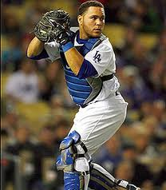
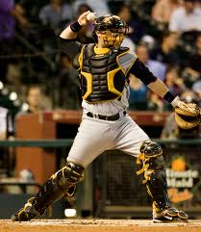

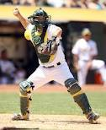
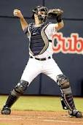
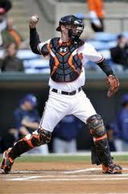
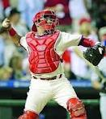
Defensive Fundamentals
THROWING
“It’s all about the footwork”
Sound & Solid Foundation (Base)
RECEIVE THE BALL FIRST!
Be quick, but don’t rush
  Better to have a good through late, than a bad throw early
Receive & Transfer (up to ear – Russell Martin)
“Jab Step” to throwing position
Drive Left Shoulder to target (stride foot will follow)
Average stride, strong front-side (equal weight transfer)
Stay “on top of the ball” & find 4-seam grip
Strong base (balanced), “Power-T” (strong front-side), driving left shoulder, on top of ball

Slide 10

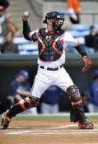

Defensive Fundamentals
THROWING DRILLS
“It’s all about the footwork”
Cross Drill (or T-Drill)
“Pop-Time” Drill
Draw a large inverted cross (or T) on the ground or on a rug (if you are indoors). Using the proper ready position, begin with your feet on the line running left to right. This line is square to the pitcher. Both feet should be in contact with this line. Using the “Jab Step,” stay low and make a throw down to second base. Stop in the “Power-T” position and check foot alignment. Both feet should be on the vertical line. Check balance as well.
GOAL: To develop proper throwing footwork to
increase accuracy and quickness on
throws to second base. The drill can be
done with or without a ball.
Instruct catcher to be in ready position behind home plate. Coach will be about halfway in between mound and home plate.
Coach will throw pitch, and catcher is to throw to second base. Coaches, use stopwatch to get “pop time.” Time begins when the ball hits the catcher’s glove, and ends when the ball hits the (SS/2B’s) glove.
Incorporate drill at beginning of season, record times, and check progress throughout season.
Times: 1.8 sec or less: MLB
1.81-2.0 sec: College/some H.S.
2.01-2.2 sec: Average H.S.
GOAL: Throw out higher percentage of base
stealers with decreased “pop time.”
Louisville Univ. Throwing to bases

Slide 11
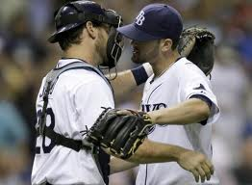
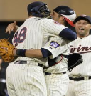
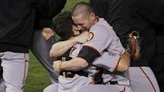
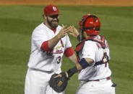
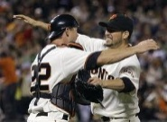
Catcher-Pitcher
Relationship
Keep Pitchers Motivated, Focused and Emotionally Stable
  Pitcher’s Mound is the loneliest place on the diamond
  Talk to pitcher between innings about previous hitters and hitters coming up next inning (include Pitching Coach in this discussion as well)
Understand Pitcher’s Strengths and Weaknesses
  Both overall, AND on each particular outing
    What is working? What isn’t? Communicate mid-game with Pitching Coach
Provide Pitcher with advice on Mechanics and Strategy
Help to Manage the Pace of the Game
  When to make a trip to the mound
    When the Coach calls it in
    When the pitcher has started an inning by throwing 2 consecutive balls
    When Pitcher is showing signs of lost focus
    After pitcher has lost his breath (covering 1st base on a “PFP”)
Alert Pitchers of Covering 1st Base
  For Left-Handed Hitters, alert pitcher prior to first pitch
Catch bullpen sessions
  Catchers will develop a heightened sense of trust with your pitching staff during bullpen sessions

Slide 12




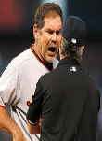




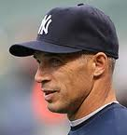
Mental Make-Up of a Good Catcher
Emotional Stability
  Ability to leave At-Bat’s at the plate, Defense first attitude
Confidence
  Take charge of situations, make decisions with confidence
Command Respect
Respect the Umpire
  Interact with Umpire professionally
  Don’t show up umpires – if pitcher does, take control
Ability to Understand Situations
  What inning, how many outs, lineup selection?
  What is the opposing team/hitter trying to accomplish?
Understanding ALL responsibilities in Bunt Coverage’s / 1st/3rd plays
  Catcher is the ONLY player on the field that has ability to see everything
Backing up Bases, Directing Traffic
Good Catchers are Leaders by design
  Communicate effectively and assertively
  Take pride in your craft – you have to “love” the position to succeed at it – (become a “student of the game”)
33% of current MLB
Managers were catchers

Slide 13
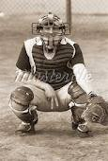
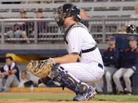
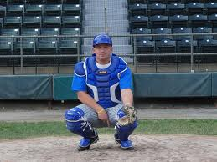
The Art of Calling a Game
Pitch Selection (general Rules)
Discuss strategy with Pitcher/Catcher before game
  What are you trying to accomplish?
Establish Fastball (or Primary Pitch)
  Most pitchers’ repertoires work off of the fastball
  Is it beneficial for the pitcher to “work backwards?”
Pitch selection changes depending on:
  The HITTER
    Lineup position, Tendencies, Stance (open vs. closed), Swing Mechanics (stride & swing path), Previous AB’s
  The SITUATION
    What inning, score, Lineup position, Runners on base
  The PITCHER’s STRENGTHS/WEAKNESSES
    What pitches are working/not working (windup vs. stretch), pitch count history
  The DEFENSE
    What is the defensive alignment (align with pitch selection)
Situational Pitch Selection
  When to “Pitch to contact” vs. when to “Pitch for a Strikeout”
“Setting up Hitters” – Successful Sequences
Saving pitches for 2nd time through the lineup
Call EVERY pitch with a purpose (plan) in mind for the sequence and desired outcome
  There is NO SUCH THING as a “Waste Pitch”

Slide 14
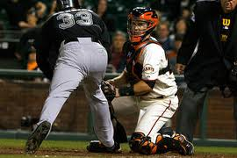
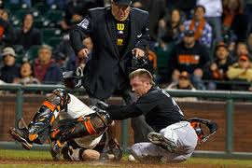
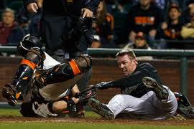
Questions / Comments
One last thing …
Have your catcher’s keep their mask on for plays at the plate!

