Slide 1


Slide 2

NEENAH BASEBALL COACHES CLINIC
PRACTICE PLANNING – KEY POINTS
  20 MINUTES ON GAME SITUATIONS
    PLAYER POSITIONING
    BACKING UP PLAYS
    FULL INFIELD
      RUNNERS STARTING AT HOME PLATE/LEAVE ON CONTACT.
      PITCHER PITCHES TO CATCHER
  EXAMPLES:
    NOBODY ON, NOBODY OUT
    RUNNER ON 1ST, 2ND OR 3RD.
    1ST & 3RD SITUATIONS.
    BASES LOADED SITUATIONS.
    BUNT SITUATIONS
    INFIELD IN
    NO DOUBLES
  EACH PLAYER MUST GO THEIR PROPER POSITIONS INCLUDING BACKING UP THE PLAY.

Slide 3
NEENAH BASEBALL COACHES CLINIC
PRACTICE PLANNING
PITCHING DRILLS
CATCHING DRILLS
  Towel Drill
  Balance to Power
  1-2-3 Drill
  Work ahead!! Throw strikes!
  Slide step
  Pick-off move to 1st
  Pick-off move to other bases
  Covering first on ball hit to right side of infield
  P-F-P Drill
  Pitch outs
  Intentional Walk
  Dry Block Drill: Front, Angle Left, Angle Right
  Block: Front, Angle Left, Angle Right
  Block and Recover.
  Receiving – soft hands, quiet body
  Exchange and throw
  Throwing to second
  Drop 3rd strike
  Pop ups
  Fielding Bunts
  3 stances
    Giving signs
    Nobody on base
    Runner on base

Slide 4
NEENAH BASEBALL COACHES CLINIC
PRACTICE PLANNING
DEFENSIVE INFIELD DRILLS
DEFENSIVE OUTFIELD DRILLS
  Cutoffs & Relays
  Infield in
  Bunt Defense
  1st & 3rd plays
  Steal defense/coverage
  Holding Runners
  Dropped 3rd strike
  Infield
  Short hops
  Soft hands
  Slow rollers
  First base dirt drill
  Four Corners Drill
  Double plays
  Pop fly communication
  Rundowns
  Cutoffs & relays
  Fly balls
  Over the head balls
  Lost ball drill
  Hitting the cut off
  Fielding ground balls
  Do or die situations
  ‘Thinking’ ahead, being prepared.
Backing up plays

Slide 5
NEENAH BASEBALL COACHES CLINIC
PRACTICE PLANNING
OFFENSIVE DRILLS - HITTING
OFFENSIVE DRILLS – BASE RUNNING
  Tee drills
    Low Tee
    10 Pull
    10 Middle
    10 Opposite
    Hands In Drill
    Top Hand Drill
    Bottom Hand Drill
  Soft Toss
    Rapid fire soft toss (quick hands)
  Bunting
    Bunting for base hit
    Bunting with runners on
    Sacrifice bunting
    Squeeze bunting
  Live Hitting
    Smart hitter
      1-0 / 2-0 / 3-1 / 0-1 / 0-2
    Bat Control
    Hit & Run
    Runner on 2nd, hit behind the runner
    Runner on 3rd, score the run
      Base hit
      Sacrifice fly
  Know your role - Execute
  Lead offs
    Primary
    Secondary
    Enticing a throw to first
    Reading the pitchers back heels
  Running bases
    Picking up the base coaches
    Rounding the bases
    Straight line from base to base
    Watch the throw in after a base hit, get as many bases as possible
    Aggressive base running (get all you can)
      1st to 3rd
      2nd to home
    Tagging up on fly balls
      No outs, tag up
      1 out, go half way

Slide 6
NEENAH BASEBALL COACHES CLINIC
If batter reaches 1st base safely he continues to hit. If batter is out hustles to RF. All the batter needs to do is reach 1st base, if he continues to run and is tagged out at another base trying to stretch the play he goes to the field.
WORK UP – 15 MINUTES
LF
CF
SS
3B
2B
RF
COACH
1B
C
BATTERS GLOVES LEFT HERE
3 BATTERS

Slide 7
NEENAH BASEBALL COACHES CLINIC
BLACK – BASES EMPTY/RUNNER ON 1ST: 3B always charges. Pitcher covers 1B side of infield. 1B stays home unless bunt is past the pitcher.
RED – RUNNER ON SECOND: 3B reads/is in. Stay home unless pitcher can’t reach. P covers 3rd base line. 1B charges. 2B covers first.
Little league bunt defense
LF
CF
SS
3B
2B
RF
P
1B
C

Slide 8
NEENAH BASEBALL COACHES CLINIC
Hard throw back to the pitcher, no hesitation. Catcher doesn’t ‘check’ the runner.
Throw to 2nd base. Runner at 3rd can score. Get the out.
Fake throw to 2nd, Snap throw to 3rd.
Catcher checks runner, quick throw to 2nd or SS crashing in.
FIRST & THIRD SITUATIONS
LF
CF
SS
3B
2B
RF
P
1B
C

Slide 9
NEENAH BASEBALL COACHES CLINIC
Player pursuing the runner holds the ball in throwing hand/high and runs player at full speed towards the next base. Try to get the runner committed. When the next position player wants the ball call ‘ball’. Player throws ball to receiver and gets out of baseline and falls in behind the next base. Player receiving the ball catches and makes tag moving forward.
KEYS:
Try To limit the amount of throws.
Both defensive sides should be cutting down the distance.
PICKLE SITUATION
LF
CF
SS
3B
2B
RF
P
R
1B
C

Slide 10
NEENAH BASEBALL COACHES CLINIC
OUTFIELD:
Fly balls hit to the outfielders. Right/Left/Over the head.
Emphasize the need to always hit your cut off
INFIELD:
Round of ground balls to first/double play/infield in come home.
Rotate positions so all learn the different roles.
Rotate Outfielders to Infield after about 15 – 20 minutes.
INFIELD / OUTFIELD PRACTICE
5/6 OUTFIELDERS
SS
3B
CUT OFF
2B
1B
COACH
C
2 COACHES

Slide 11
NEENAH BASEBALL COACHES CLINIC
SOFT TOSS STATION WIFFLE BALLS
Hitting Practice:
Split the team up into 3 groups (less standing around)
Tee station:
*5 outside/middle/in
*5 outside/middle bottom hand drill
Soft toss station:
Soft toss by the coach, focus on line drives .
Live Hitting:
Coach throws under hand front toss. Under hand front toss allows the coach to throw mostly strikes and allows the hitters to actually work on their mechanics. Mix up inside/middle/out.
5-7 swings, next hitter.
HITTING PRACTICE
H1
COACH
2-3 ON DECK
COACH
FRONT TOSS HARDBALL – 30’ distance
H1
TEE STATION
WIFFLE BALLS
5 OUTSIDE
5 MIDDLE
5 INSIDE
H1
COACH
2-3 ON DECK
2-3 ON DECK

Slide 12
NEENAH BASEBALL COACHES CLINIC
Pitching Practice:
No bats used!!
8-10 pitches from the stretch. Rotate pitchers to hitters, hitters to catchers, catchers to pitchers.
2nd time through, 10-12 pitches from the windup.
3rd time through, 12-15 pitches. Mixture of stretch and windup.
Develop as many pitchers as possible. Everyone should pitch in practice unless the player has absolutely no interest.
PITCHING PRACTICE
C4
H4
C3
H3
COACH
P4
P3
P1
P2
H1
C1
H2
C2

Slide 13
NEENAH BASEBALL COACHES CLINIC
BATTING PRACTICE:
Always use the hitting nets, never hit any balls into the fences.
Things to focus on:
Distance from the plate should be no more than 6 – 8”.
Wide base, short stride directly to the pitcher.
Hand path to the ball, keep the hands inside the baseball.
Strong front side, locked out front leg.
BATTING PRACTICE CAGE ONLY DRILLS
Live hitting – front toss. 2 bunts, 3 outside, 3 middle, 3 inside rotate
Live hitting – Coach pitching live. 2 bunts, 3 outside, 3 middle, 3 inside rotate
Tee outside
Tee middle
Tee bottom hand outside
Tee bottom hand middle

Slide 14
NEENAH BASEBALL COACHES CLINIC
DEFENSIVE SITUATIONS

Slide 15
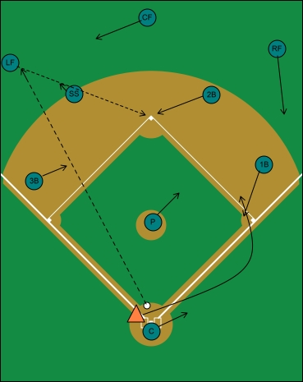
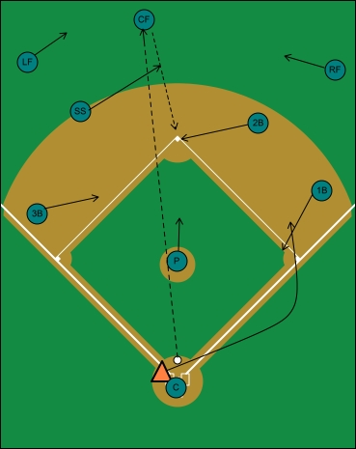
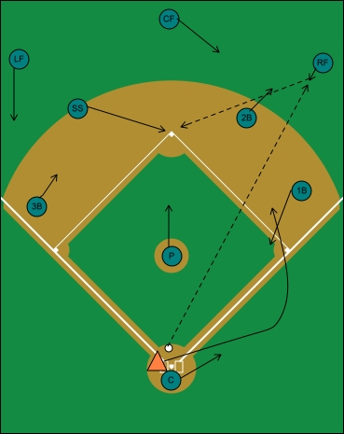
NEENAH BASEBALL COACHES CLINIC
SINGLE CUT OFFS NOBODY ON BASE
· P: Moves halfway between the mound and second base
· C: Follows runner towards 1B, as he would on a ground ball that isn't going through
· 1B: Comes down to the inside of first base, ready for a pickoff throw should the runner take too big a turn
· 2B: Covers second base
· SS: Cutoff between LF and 2B
· 3B: Moves closer to second base
· CF: Moves toward 2B
· RF: Takes an angle between 2B and 1B to backup the throw
· LF: Catch ball, throw "through" the cutoff to 2B
· P: Turns around and goes halfway to 2b
· C: Remains at plate as the final backup
· 1B: Comes over to 1B, in the event of an extra wide turn by the runner
· 2B: Goes to 2B to cover the base
· SS: Goes out to CF as cutoff
· 3B: Moves toward center of the diamond, in case of a bad throw
· LF: Move towards center field
· RF: Move towards center field
· CF: Catch ball and throw "through" cutoff to 2B
P: Turns around, moves halfway to second base
· C: Starts to backup 1B, then stops when he sees the ball go into the outfield
· 1B: Comes to 1B
· 2B: Goes out to RF as the cutoff
· SS: Covers 2B
· 3B: Backs up throw
· LF: Comes in to backup throw
· CF: Moves in and towards right field
· RF: Fields the ball and throws "through" the cutoff to 2B

Slide 16
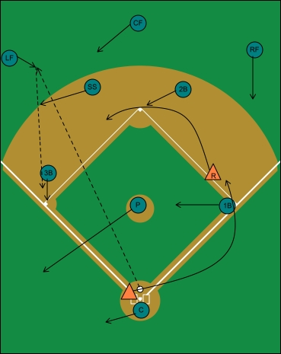
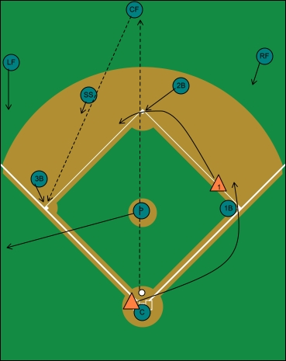
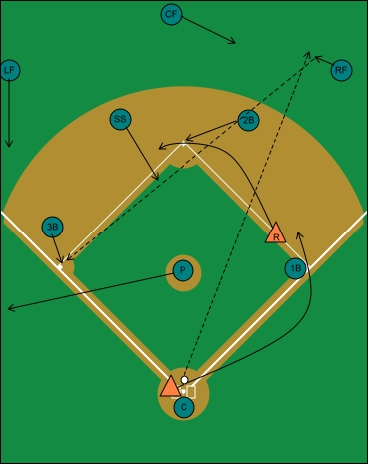
NEENAH BASEBALL COACHES CLINIC
SINGLE CUT OFFS RUNNER ON FIRST
· P: Back up 3B
· C: Back up 3B
· 1B: Come in towards mound, in case of bad hop off 3B
· 2B: Cover 2B
· SS: Cutoff between LF and 3B
· 3B: Cover 3B
· CF: Go in and towards LF
· RF: Back up possible throw from LF to 2B
· LF: Field ball, throw to 3B
· P: Back up 3B
· C: Stay at plate
· 1B: Stay at 1B, possible pick of runner with too wide a turn
· 2B: Cover 2B
· SS: Cutoff between CF and 3B
· 3B: Cover 3B
· LF: Backup behind 3B
· RF: Comes toward infield to back up possible cutoff throw to 2B
· CF: Fields ball, throws "through cutoff to 3B
· P: Back up 3B
· C: Stay at plate
· 1B: Stay at 1B, possible pick of runner with too wide a turn
· 2B: Cover 2B
· SS: Cutoff between RF and 3B
· 3B: Cover 3B
· LF: Back up 3B
· CF: Go toward right field, tell him where to throw
· RF: Fields the ball, throw "through" the cutoff to 3B

Slide 17
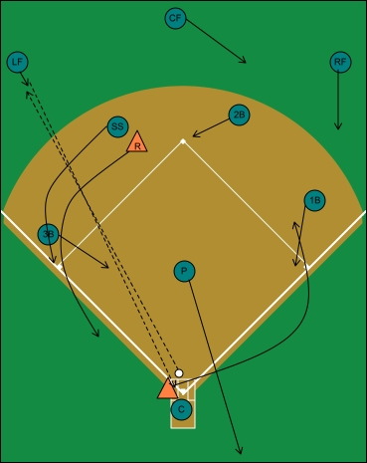
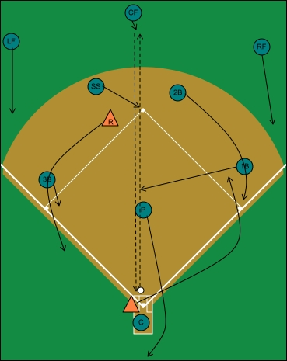
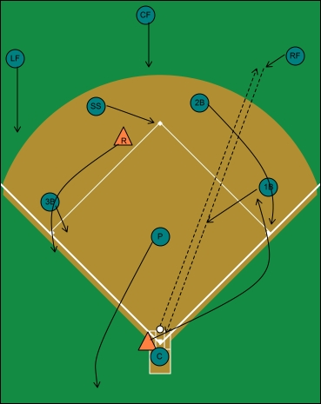
NEENAH BASEBALL COACHES CLINIC
SINGLE CUT OFFS RUNNER ON SECOND
· P: Back up home plate
· C: Cover plate, line up the cutoff man
· 1B: Come down inside 1B
· 2B: Cover 2B
· SS: Cover 3B
· 3B: Come to infield grass for cutoff between LF and C
· CF: Move towards RF and back up possible throw to 2B
· RF: Move towards 1B as a backup
· LF: Field ball, throw "through" cutoff to the plate
· P: Back up home plate
· C: Cover plate, line up cutoff man
· 1B: Center of infield, behind the pitcher's mound for cutoff between CF and C
· 2B: Cover 1B
· SS: Cover 2B
· 3B: Come inside base, cover 3B
· LF: Backup 3B
· RF: Back up 1B
· CF: Field ball, throw "through" cutoff to home plate
· P: Back up home plate
· C: Cover plate, line up cutoff man
· 1B: Come into grass as cutoff between RF and C
· 2B: Cover 1B
· SS: Covers 2B
· 3B: Come to inside of 3B, cover 3B
· LF: Back up 3B
· CF: Backup 2B
· RF: Fields the ball and throws "through" the cutoff to home plate

Slide 18
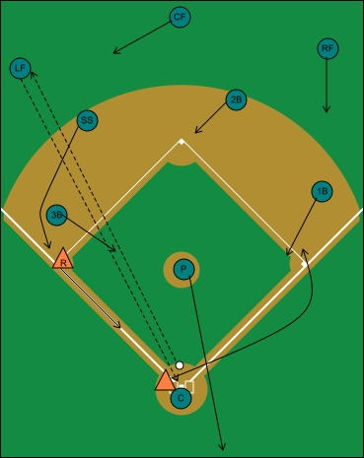
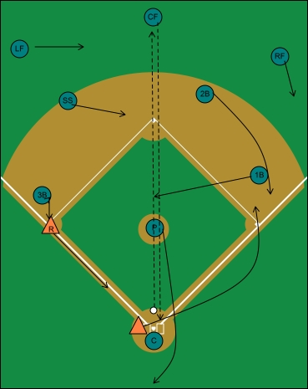
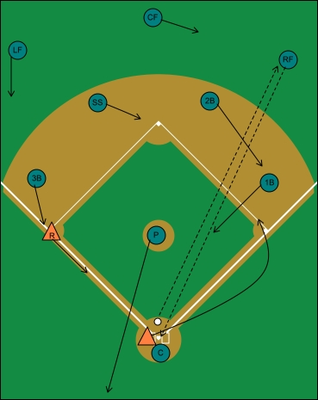
NEENAH BASEBALL COACHES CLINIC
SINGLE CUT OFFS RUNNER ON THIRD
· P: Backup home plate
· C: Cover home plate, line up cutoff
· 1B: Come down, inside 1B
· 2B: Cover 2B
· SS: Covers 3B
· 3B: Infield grass, cutoff between LF and C
· CF: Start towards LF
· RF: Backup 2B, in case the fly ball is dropped
· LF: Catch ball, throw "through" cutoff to home plate
· P: Backup home plate
· C: Cover home plate, line up cutoff
· 1B: Go behind mound as cutoff
· 2B: Cover 1B
· SS: Covers 2B
· 3B: Cover 3B
· LF: Move towards CF
· RF: Move towards 1B
· CF: Make catch, throw "through" cutoff man to plate
· P: Backup home plate
· C: Cover home plate, line up cutoff
· 1B: Come into grass, cutoff between RF and C
· 2B: Cover 1B
· SS: Covers 2B
· 3B: Cover 3B
· LF: Backup 3B
· CF: Moves towards RF
· RF: Make catch, throw "through" the cutoff to home plate

Slide 19
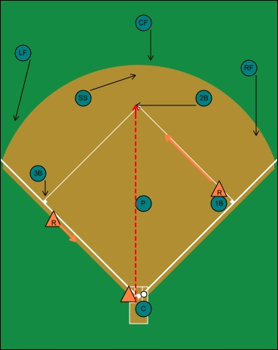
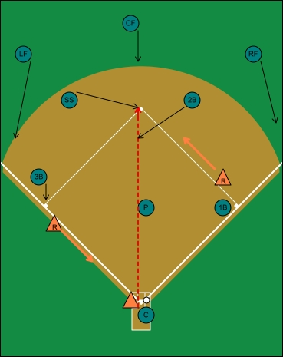
NEENAH BASEBALL COACHES CLINIC
FIRST AND THIRD SITUATIONS
· P: Deliver pitch.
· C: Look at 3B runner to freeze him, as you throw to 2B.
· 1B: Hold runner on
· 2B: Cover base or backup base, dependent upon right or left hand hitter.
· SS: Cover base or backup base, dependent upon right or left hand hitter.
· 3B: Cover 3B.
· LF: Backup 3B.
· CF: Backup 2B.
· RF: Backup 1B.
· P: Deliver pitch.
· C: Looks at 3B runner to freeze as he throws to 2B.
· 1B: Hold runner on.
· 2B: Come in front of base on grass cut, if runner from 3B goes, cut ball off and throw to home.
· SS: Cover 2B.
· 3B: Cover 3B. If runner goes, yell "runner" to alert the infield.
· LF: Backup 3B.
· CF: Backup 2B.
· RF: Backup 1B.

Slide 20
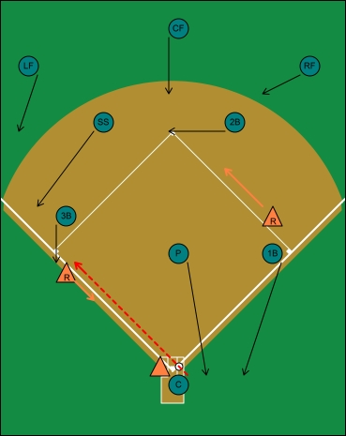
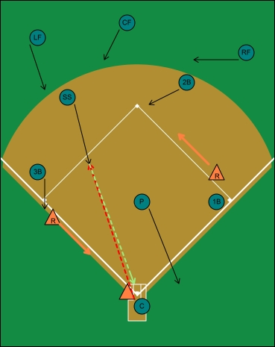
NEENAH BASEBALL COACHES CLINIC
FIRST AND THIRD SITUATIONS
· P: Deliver pitch, come to home plate in case of a rundown.
· C: Good arm action to 2B, reset and throw to third.
· 1B: Hold runner on, then come down to home plate and backup pitcher.
· 2B: Cover 2B.
· SS: Cover 3B.
· 3B: Catch throw and make tag, or set up for rundown.
· LF: Backup 3B.
· CF: Backup 2B.
· RF: Backup 2B.
· P: Deliver pitch, backup home plate.
· C: Catch pitch, throw to shortstop coming in to grass.
· 1B: Hold runner on, wait and see if a rundown develops, if so backup home plate.
· 2B: Cover second base.
· SS: Run straight at catcher, catch ball and throw home if runner is going. If not, fake or deke the throw, whirl and see if you can pick runner at 2B.
· 3B: Cover 3B, yell "runner" if he goes.
· LF: Backup shortstop.
· CF: Backup shortstop.
· RF: Backup 2B.

Slide 21
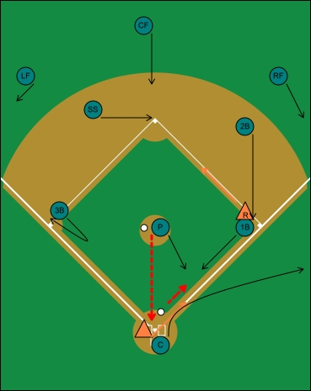
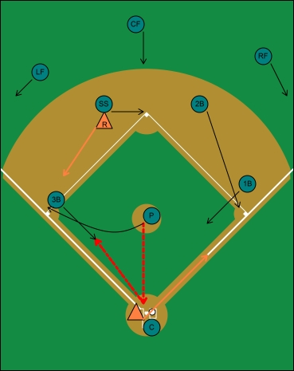
NEENAH BASEBALL COACHES CLINIC
BUNT DEFENSE – RUNNERS ON BASE
P: Has bunts up the third base side and in front of the mound. If the 3B fields the bunt, the pitcher goes to cover 3B.
C: Has balls out in front of the plate, as well as making the call as to where the play is going. Look to backup first base, in case there is a DP attempt.
1B: Holds runner on, breaks on the pitch, responsible for balls bunted up the first base side.
2B: Covers first base.
SS: Covers second base.
3B: Reads the bunt, covers 3B, unless the ball is bunted on the third base side, where the pitcher will not be able to field it. He must then make a quick decision and come field the bunt.
LF: Comes in behind 3B to backup a possible throw from first base to third, should the runner from 1B keep going.
CF: Heads straight for 2B, to backup the possible throw to second.
RF: Comes to the right field line to backup the throw to first base.
P: Responsible for bunts up the third base side, if 3B fields bunt pitcher goes to 3B.
C: Fields anything he can get to out in front of the plate, and makes the call as to where the play is going to.
1B: Holds runner on first, crashes on the pitch, has responsibility for balls bunted up the first base side.
2B: Cover 1B. If the throw comes to 1B, look to third base right away. You may have an opportunity to back pick on an extra wide turn, or the runner may just keep on going. Be ready!
SS: Works the runner at second, goes to second on the bunt.
3B: In this defense, the 3B is responsible to remind the pitcher to get the third base side. If the pitcher does not field the bunt, but the third baseman does, pitcher goes to third base.
LF: Comes hard towards 3B to backup.
CF: Comes hard towards 2B.
RF: Comes to the right field line to back up throw to first base.

Slide 22
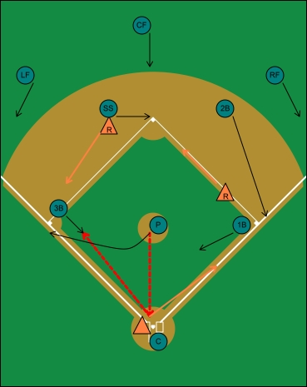
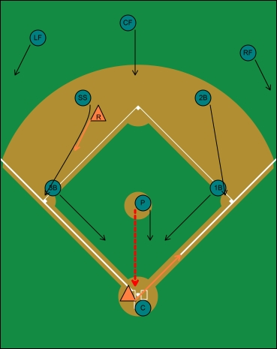
NEENAH BASEBALL COACHES CLINIC
BUNT DEFENSE – RUNNERS ON BASE
P: Responsible for bunts up the third base side, if 3B fields bunt pitcher goes to 3B.
C: Fields anything he can get to out in front of the plate, and makes the call as to where the play is going to.
1B: Holds runner on first, crashes on the pitch, has responsibility for balls bunted up the first base side.
2B: Cover 1B. If the throw comes to 1B, look to third base right away. You may have an opportunity to back pick on an extra wide turn, or the runner might just keep on going. Be ready!
SS: Works the runner at second, goes to second on the bunt.
3B: In this defense, the 3B is responsible to remind the pitcher to get the third base side. If the pitcher does not field the bunt, but the third baseman does, pitcher goes to third base.
LF: Comes hard towards 3B to backup.
CF: Comes hard towards 2B.
RF: Comes to the right field line to back up throw to first base.
P: Waits to throw until the SS breaks for 3B, otherwise the runner can beat SS to the base. Pitcher is then responsible for the bunt in front of the mound.
C: Fields anything he can get in front of the plate, and also makes the call as to where the play is going.
1B: Crashes and has any bunt up the first base side.
2B: Cover first base.
SS: Keep runner close at 2B, then starts the wheel play by breaking for 3B.
3B: Crashes on pitch.
LF: Backup 3B.
CF: Come hard to 2B, may be able to back pick the runner from first.
RF: Backup throw to 1B.

Slide 23
NEENAH BASEBALL COACHES CLINIC
THROWING

Slide 24
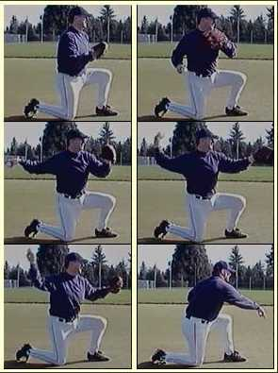
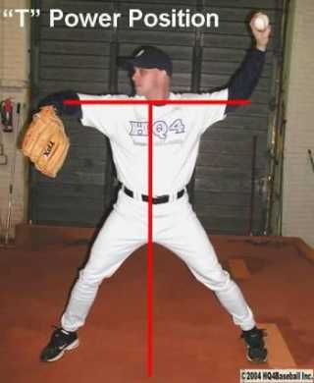
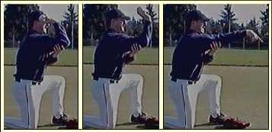
NEENAH BASEBALL COACHES CLINIC
PRE GAME THROWING PROGRESSION/ THROWING MECHANICS
One knee, arm up, flick wrist
On e knee w/glove – equal opposite
Standing Power T – (emphasize proper grip, ball direction, straight line elbow, proper targeting with front elbow)
Crow hop
Stretch it out w/crow hop – (emphasize, stay on top of the ball)
Bring it in – 2 players moving toward each other, catch two hands, quick transfer, quick throw.

Slide 25
NEENAH BASEBALL COACHES CLINIC
FIELDING

Slide 26
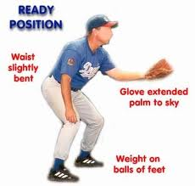
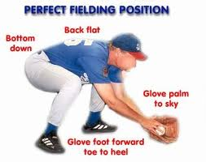

NEENAH BASEBALL COACHES CLINIC
FIELDING DRILLS/MECHANICS
Ready position, moving with the pitch
1,2 field, proper fielding position
  Glove down
  Butt down
  Flat back
  Arms out front
  Field the ball in front of you
    Vision
    Reaction to bad bounce
  Rounding to the ball
  Field through the ball
  Momentum taking you through the throw towards the target
  Backhands/forehands
  Cut offs
Glove/bat drill
Short hop / Rolling drill (partners)
Soft Hands
Middle infield pivots
  Underhand feeds – how, when
  Showing the ball
  Drop to one knee
  Receiving the ball, show good target
Infield Positioning
Outfield
  First step back
  Drop steps
  2 hands
  Communication/cut offs

Slide 27
NEENAH BASEBALL COACHES CLINIC
CATCHING

Slide 28
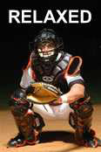
NEENAH BASEBALL COACHES CLINIC
CATCHING DRILLS/MECHANICS
Relaxed Stance
A general stance most catchers use with the bases empty and less than two
strikes is called a "relaxed" stance. The relaxed stance begins by squatting with
your feet shoulder-width apart. Your hips and shoulders should be square to the
pitcher and your feet straight across or slightly (an inch or two) staggered. In
other words, when looking down at home plate your feet should be parallel with
the front edge of the plate (i.e. straight across). Your weight should be on the
insides of your feet and you must be balanced. Balance is key. You should not
be falling over and it should be difficult for someone to push you over. Get as low
as comfortably possible while still being in an athletic position ready to react to
anything. The purpose of getting low is to allow the umpire to clearly see and call pitches in the lower half of the zone. Every catcher is different so you should
experiment and find a stance that is comfortable and balanced.
Setting a proper arm position and arm angle are important. Your receiving arm
(mitt hand) should be relaxed (somewhere near the middle of being completely
straight and being completely bent toward your chest) and your palm should be
pointed at the pitcher. DO NOT set up with your receiving arm straight or you
may interfere with the batter's swing (catcher's interference). DO NOT have your
arm totally bent, as this will slow your ability to react to wild pitches. Being
extended or completely bent will also hamper your ability to receive and frame
pitches. Your elbow should be below your mitt. This helps in framing pitches that
are low and to the left side of your body (your elbow has less distance to travel to
get around the pitch). For right-handed catchers (most catchers are right
handed), your throwing hand should be behind your right shoe to avoid being hit
by a fouled pitch.
KEYS: Square to Pitcher, Comfort, Balance, Low Athletic Position, Arm Position,
Palm Toward Pitcher, Target, Relaxed Stance

Slide 29
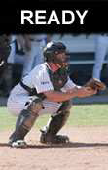
NEENAH BASEBALL COACHES CLINIC
CATCHING DRILLS/MECHANICS
Ready Stance
The ready stance is used when there are runners on base
and/or two strikes on the batter. In both cases you need to be
ready to block a wild pitch or quickly throw out a base runner.
The ready stance is simply a raised squat where the weight is
now on the balls of your feet instead of the instep and your
butt is slightly raised. This allows for quick reactions. Even
though you are raised, keep low in your stance. Remember
the umpire. Give your pitcher as much help as possible by
allowing the umpire to see the entire zone. The distance
between your feet will probably increase in a raised squat
position. This is fine and expected.
Slightly Stagger Your Feet. One area where I see bad information being passed along is foot alignment. Foot
alignment is very important in a ready stance. Your feet should be SLIGHTLY
staggered. DO NOT stagger your feet more than a few inches from parallel.
Some coaches teach their players to "cheat" with their feet over staggered. This
is BAD and here's why. The reason coaches teach their players to over stagger
their feet is to help in throwing out runners attempting to steal. This may help
them set their feet quicker but it takes away from the catcher's ability to block wild
pitches. Lining up in an extremely staggered stance forces the hips and the
shoulders to NOT BE SQUARE to the pitcher. It is much harder for a catcher to
turn his body and successfully block a pitch in the dirt. It is even harder to block a
pitch in the dirt to either side of the catcher. A runner attempting to steal is trying
to EARN that base and a catcher still has a great shot at throwing out the runner
without cheating with his feet. Almost all bases are stolen off the pitcher, not the
catcher. A runner on base will benefit from a catcher who is out of position
(staggered feet) and is unable to block a ball in the dirt. Make the offense earn
the base and do not give it away by being out of position.
IMPORTANT POINT: Keep your hips and shoulders square to the pitcher and
slightly stagger your feet!
KEYS: Ready Stance, Hips and Shoulders Square to Pitcher, Weight on Balls of
Feet, Low Athletic Position, Arm Position, Palm Toward Pitcher, Target, Fist
Behind Glove

Slide 30
NEENAH BASEBALL COACHES CLINIC
CATCHING DRILLS/MECHANICS
Blocking
Besides receiving and communication, the most important skill for a catcher to
develop is the ability to block pitches in the dirt. Teams will take advantage of a
catcher who is a poor blocker. Catchers who can block well keep base runners
from advancing and instill confidence in their pitchers. A confident pitcher is a
better pitcher.
Blocking is simply defined as using whatever means available to knock down and
control a pitch that bounces. The key term is control. I may be able to get in front of the ball with my body, but if that ball bounces too far away from me (i.e. I don't
control it) a good base runner will still advance. The following basic technique
should be used when blocking and controlling pitches in the dirt.
Technique
The catcher should already be in the ready stance when attempting to block.
Your hips and shoulders should be square to the pitcher. Recognize the pitch
and quickly thrust your knees to the ground while remaining square to the
pitcher. Clear your feet by moving them back and to the side, with your toes
pointed away from your body. Your knees should almost land where your feet
were located and be spread apart just past shoulder width. Do not just fall
forward to your knees, as this takes too long. You need to get down quickly.
Clear your feet and thrust your knees down.
Your glove should move from your target position to directly between your legs
with your palm up, facing the pitcher and your throwing hand positioned behind
the glove. The web of the glove should be against the ground and both arms
should be snug with your body. This hand and arm position keeps a ball from
going through your five hole. Tuck both elbows against your body to provide a
greater surface area for blocking.
The upper body position is critical to controlling the deflection of the ball. Keeping
your shoulders square to the pitcher, round your shoulders and bend at the waist
so your upper body is leaning forward over your thighs. This creates a down
angle that will deflect a ball down in front of you and at a controlled distance. Tuck your chin to your chest so you do not get hit in the throat.
IMPORTANT POINT: DO NOT try and scoop a pitch in the dirt with your glove. This is a bad habit to get into and most of the time you will fail.
KEYS: Knock Down, Control, Thrust Knees, Glove Position, Tuck Elbows, Bend
Waist, Round Shoulders, Tuck Chin, Slide to Location, Square to Pitcher,
Breaking Ball Spin

Slide 31
NEENAH BASEBALL COACHES CLINIC
HITTING

Slide 32
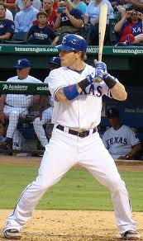
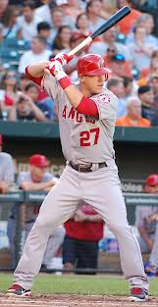
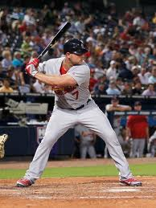
NEENAH BASEBALL COACHES CLINIC
COACHING KEYS FOR YOUNG HITTERS
STAND 6” – 8” OFF OF HOME PLATE – NO MORE!
WIDER BASE/STANCE IS BETTER. SLIGHTLY LESS THAN THE LENGTH OF THEIR BAT.
STRIDE TO THE PITCHER.
START THE BAT ON THE OUTSIDE OF THE BACK SHOULDER. PROMOTES SHORT TO THE BALL, GOOD HAND PATH.
LINE UP THE KNOCKING KNUCKLES.
SMALLER BAT IS BEST FOR YOUNG HITTERS. TEACH GOOD MECHANICS FIRST.
STANCE
STRIDE

Slide 33
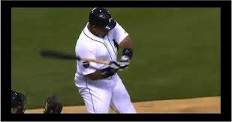
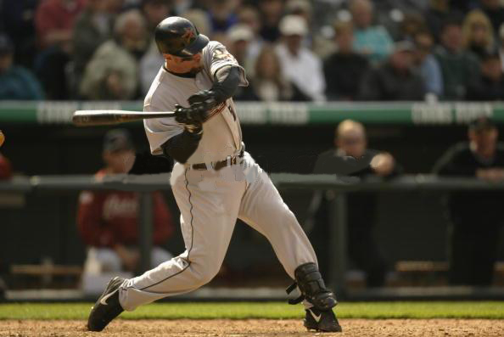
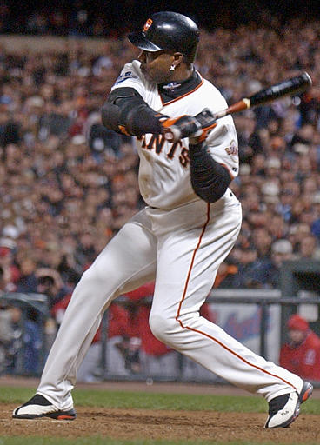
NEENAH BASEBALL COACHES CLINIC
COACHING KEYS FOR YOUNG HITTERS
STAND 6” – 8” OFF OF HOME PLATE – NO MORE!
WIDER BASE/STANCE IS BETTER. SLIGHTLY LESS THAN THE LENGTH OF THEIR BAT.
STRIDE TO THE PITCHER.
START THE BAT ON THE OUTSIDE OF THE BACK SHOULDER. PROMOTES SHORT TO THE BALL, GOOD HAND PATH.
LINE UP THE KNOCKING KNUCKLES.
SMALLER BAT IS BEST FOR YOUNG HITTERS. TEACH GOOD MECHANICS FIRST.
APPROACH POSITION

Slide 34
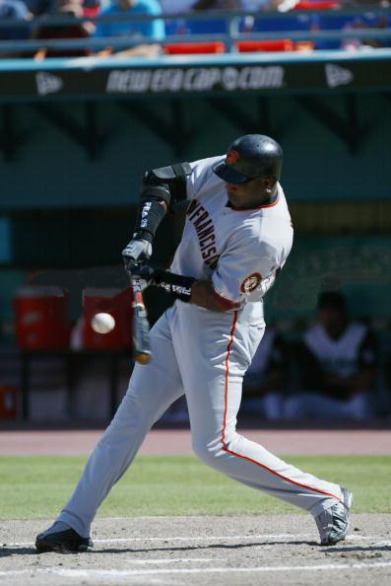
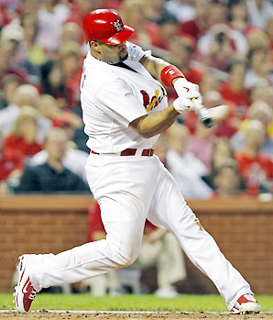
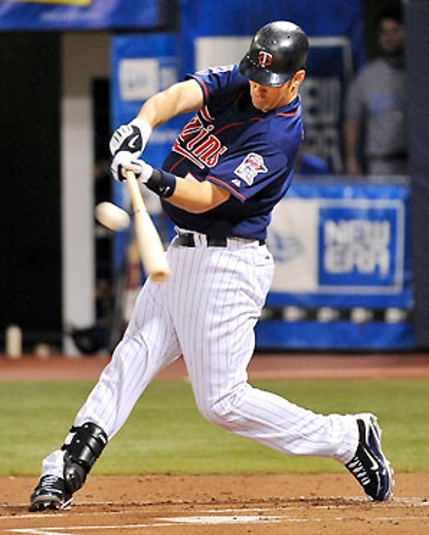
NEENAH BASEBALL COACHES CLINIC
COACHING KEYS FOR YOUNG HITTERS
STAND 6” – 8” OFF OF HOME PLATE – NO MORE!
WIDER BASE/STANCE IS BETTER. SLIGHTLY LESS THAN THE LENGTH OF THEIR BAT.
STRIDE TO THE PITCHER.
START THE BAT ON THE OUTSIDE OF THE BACK SHOULDER. PROMOTES SHORT TO THE BALL, GOOD HAND PATH.
LINE UP THE KNOCKING KNUCKLES.
SMALLER BAT IS BEST FOR YOUNG HITTERS. TEACH GOOD MECHANICS FIRST.
CONTACT POSITION

Slide 35
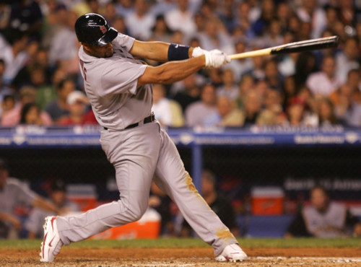
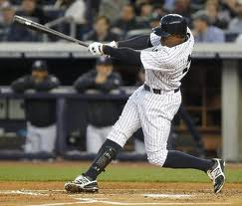
NEENAH BASEBALL COACHES CLINIC
COACHING KEYS FOR YOUNG HITTERS
STAND 6” – 8” OFF OF HOME PLATE – NO MORE!
WIDER BASE/STANCE IS BETTER. SLIGHTLY LESS THAN THE LENGTH OF THEIR BAT.
STRIDE TO THE PITCHER.
START THE BAT ON THE OUTSIDE OF THE BACK SHOULDER. PROMOTES SHORT TO THE BALL, GOOD HAND PATH.
LINE UP THE KNOCKING KNUCKLES.
SMALLER BAT IS BEST FOR YOUNG HITTERS. TEACH GOOD MECHANICS FIRST.
POWER V POSITION

Slide 36
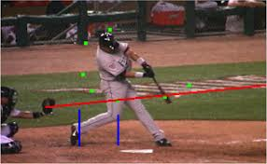
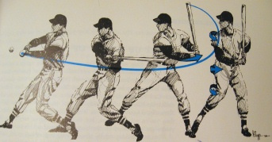
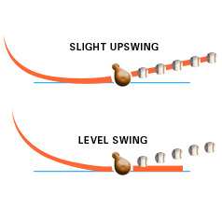
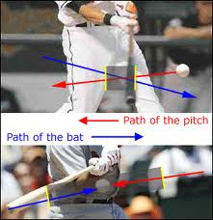
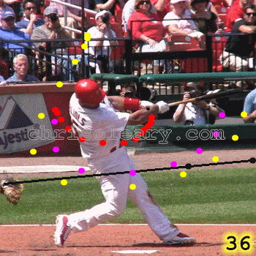
NEENAH BASEBALL COACHES CLINIC
COACHING KEYS FOR YOUNG HITTERS
STAND 6” – 8” OFF OF HOME PLATE – NO MORE!
WIDER BASE/STANCE IS BETTER. SLIGHTLY LESS THAN THE LENGTH OF THEIR BAT.
STRIDE TO THE PITCHER.
START THE BAT ON THE OUTSIDE OF THE BACK SHOULDER. PROMOTES SHORT TO THE BALL, GOOD HAND PATH.
LINE UP THE KNOCKING KNUCKLES.
SMALLER BAT IS BEST FOR YOUNG HITTERS. TEACH GOOD MECHANICS FIRST.
BAT PATH

Slide 37
NEENAH BASEBALL COACHES CLINIC
GAME DAY ROUTINE

Slide 38
NEENAH BASEBALL COACHES CLINIC
GAME DAY ROUTINE
PLAYERS SHOULD ARRIVE @ 45 MINUTES PRIOR TO THE START TIME.
RUNNING / STRETCHING / WARM-UP
THROWING PROGRESSION
BATTING CAGES/DRY DRILLS
  T-WORK (OUTSIDE/MIDDLE/INSIDE)
  SOFT TOSS
  WIFFLE BALLS – FRONT TOSS
  FRONT TOSS IN THE CAGE
  LIVE THROWING IN THE CAGE
INFIELD/OUTFIELD (JR/SR/USSSA)
  GROUND BALLS TO FIRST
  DOUBLE PLAY
  HOME, FOLLOW FOR 2ND BALL TO FIRST
  FLY BALLS FROM FOUL LINE
POST GAME
  LINE UP TO SHAKE HANDS WITH THE OPPOSING TEAM AND UMPIRES.
  CLEAN UP AND CLEAR OUT OF THE DUGOUT ASAP.
    MAKE SURE THIS IS A PRIORITY OIF THERE IS A GAME FOLLOWING YOURS.
  IF YOU ARE THE LAST GAME, PLEASE RAKE UP THE FOLLOWING AREAS
    HOME PLATE/BATTERS BOX
    PITCHERS MOUND
    AROUND THE BASES
  MEET WITH THE PLAYERS
    MEET OFF THE FIELD IF THERE IS ANOTEHR GAME FOLLOWING YOURS.

