Slide 1


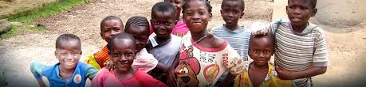
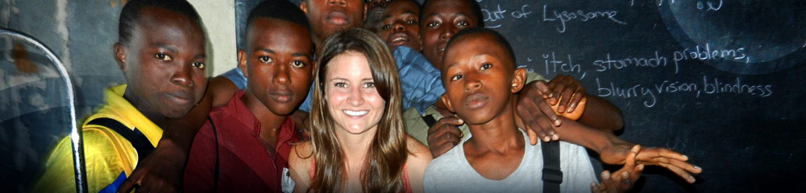
WAMM-EPPA Partnership Meeting
Phil Doyle
Jan .7.2014

Slide 2
West African Medical Missions(WAMM)
About
Established in 2009, WAMM is a 501(c)3 international non- profit organization with offices in the US and Sierra Leone
Mission
To strengthen the existing health capacities of West Africa through education, community empowerment and civic engagement
Vision
To become the most effective organization cultivating local cures to the health disparities and inequalities afflicting West Africa
Values
Health, Equality, Leadership, Innovation, Education,
Sustainability, Youth and Gender empowerment,

Slide 3

WAMM Working Model
Partners with national organizations to channel skilled students into positions that improve institutional capability
An 8-week summer program that meets three times a week and engages students in a classroom setting to learn science through medicine
Young Scholars Program (YSp)
Institutional Strengthening Program (ISp)
Research Associate Program (RAp)
Partners locally trained collegiate level research teams with researchers

Slide 4
WAMM-EPPA partnership
WAMM’s mission of bringing international volunteers together with local students and health professionals to address community health issues is a natural fit for EPPA’s Scribe Program.
The Scribe program is designed to help prospective medical students learn the nuances of clinical decision making and experience the pride of being a real contributor to the future of healthcare
Experential Learning
Dedicated Volunteers
WAMM is committed to resolving health disparities within communities via participatory education and civic engagement with the local population

Slide 5
Scribe Centered GHV Experience
GHV is a holistic learning opportunity
  Public Health
  Understand the challenge of scope and scale, and of working around systemic constraints in designing a sustainable public health program
  International Experience
  Discover the joy of coming face to face with alternative perspectives and lifestyles
  Clinical Learning
  An enviable opportunity to understand, compare and contrast a healthcare system in a developing country.
  Leadership

Slide 6
WAMM-EPPA Partnership Activity List
Activity | Objective | Desired Outcome | Indicators | Tentative Dates
Finalize Partnership Agreement | Document the motivation, vision and goals for the partnership | Collaborative project creation | Both organizations sign the partnership agreement | 4.Jan.2014
January Lecture to introduce WAMM to Scribes | Discuss WAMM-EPPA partnership goals and experiential learning opportunities with Scribes | Get scribe buy-in Get a preliminary idea of the programs that resonate well with Scribes | Feedback during and after the lecture Sign-up for planning committee | 7.Jan.2014
WAMM-EPPA partnership meetings | Create opportunities to for the key stakeholders and decision makers to discuss the next-steps to transition Scribes into the GHV experience | Determine the scale and scope of participation by Scribes Create finalized process outline for GHV's (see examples below) in terms of Timeline Key goals Establish metrics & indicators | A clear indication of the number of Scribes willing to participate in the program Requests from Scribes for more information about day to day learning activities, and other facilities in SL Formal offerings and outline available (Brochure, etc) | xx.Feb.2014 xx.March.2014
April Lecture | Discuss global health scribe centered project | Fill remaining placements Gain additional insights | Program fulfillment Attendance | xx.April.2014

Slide 7
Proposed GHV Scribe Roles for 2014 Program
Activity | Objective | Desired Outcome | Indicators
Aberdeen Women’s Centre | Place high value volunteer with community healthcare advocate/professionals (Gender issues context) | Build long-term sustainable community health advocate role for WAMM SL staff | Field reports from scribe volunteer Local student placement with volunteer turnover
Connaught Hospital | Place volunteer with premier healthcare partner in urban center | Establish clinical support roles for local students Facilitate global health and social medicine leadership opportunities for volunteers | Final reflection from volunteers (seasoned, globally aware scribes) Local student placement in clinical support roles
World Food Programme/Marie Stopes Sierra Leone | Place volunteer with maternal and nutritional health advocates in marginalized communities | Establish community advocate and leadership roles for local students Facilitate social medicine immersion for volunteers | Final reflection from volunteers Elevation of local students as community health advocates and leaders

Slide 8
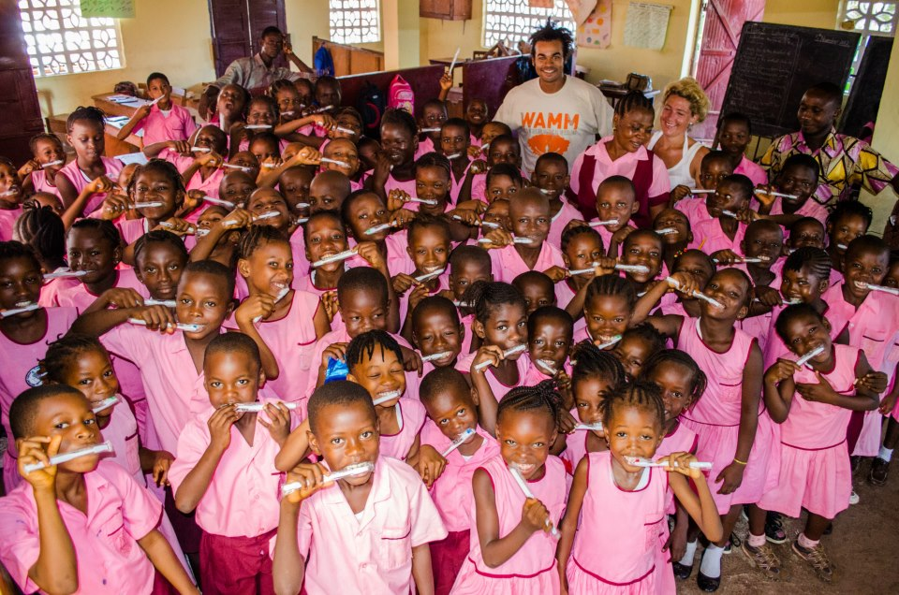
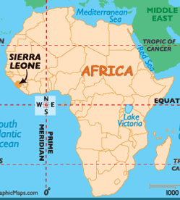

Slide 9
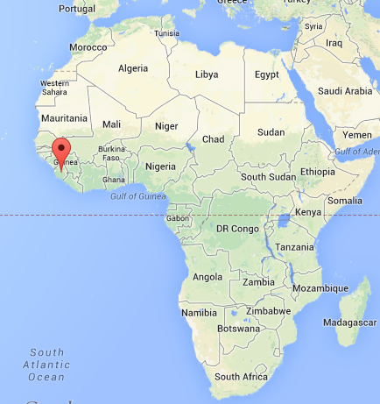
Where is Sierra Leone?

